Slide 1
Physical Activity
Our school is working towards the Active School Flag.
This is a record of the work that we have undertaken.
Notes:
Please read the GUIDELINES: ASF Template Slideshows document in the ASF Members Area on www.activeschoolflag.ie (Website Showcase section)

Slide 2
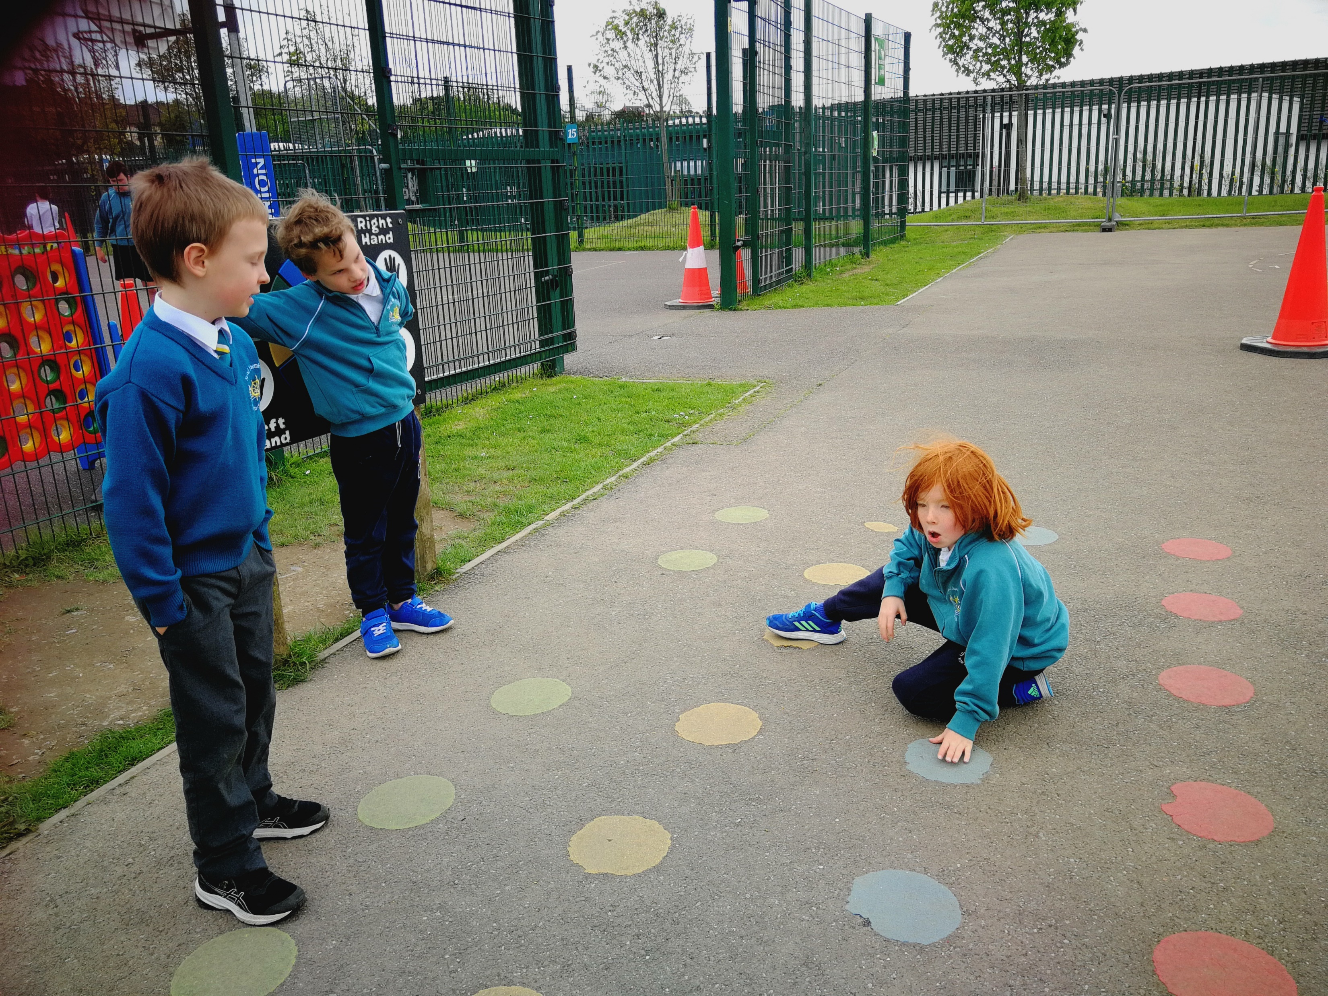
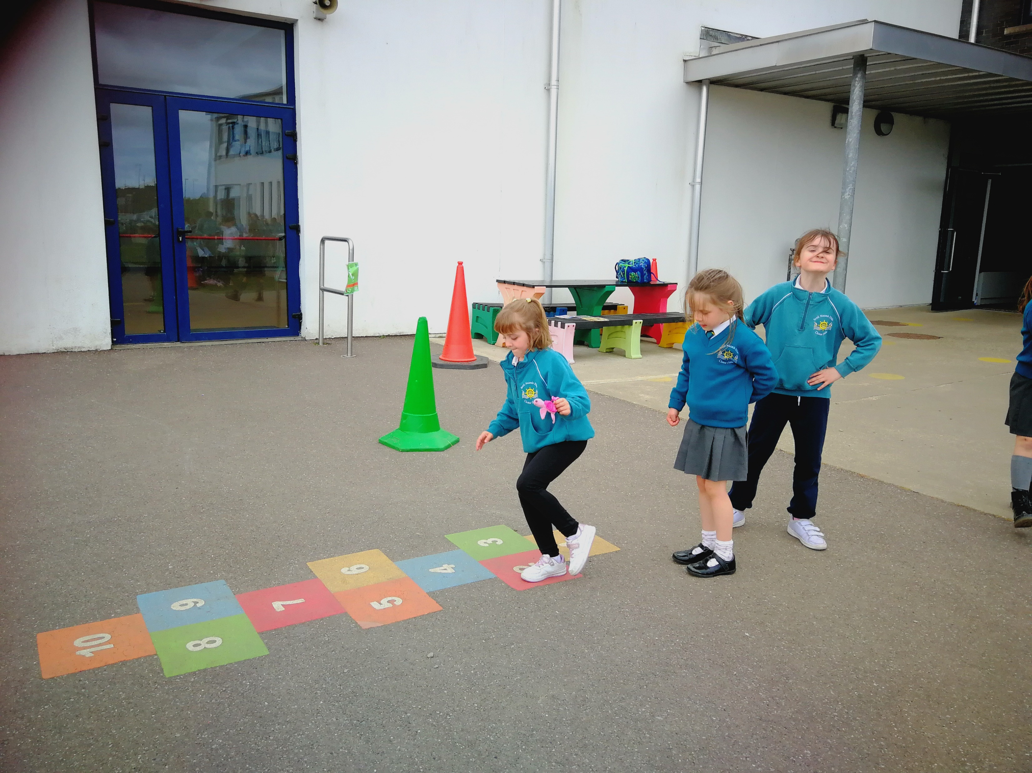
Playground Equipment
www.activeschoolflag.ie
Notes:
Please provide evidence of how playground equipment is used to promote physical activity during break-times.

Slide 3
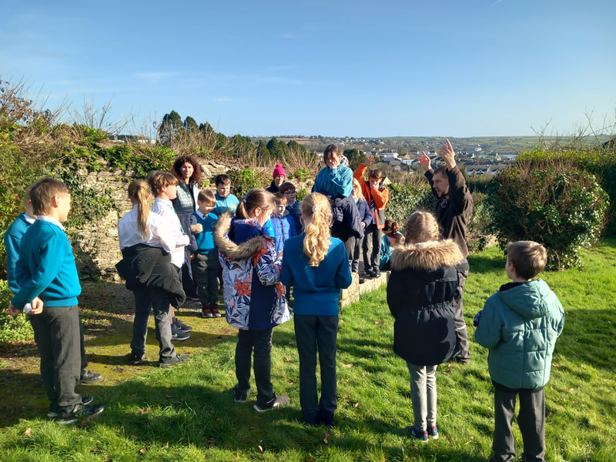
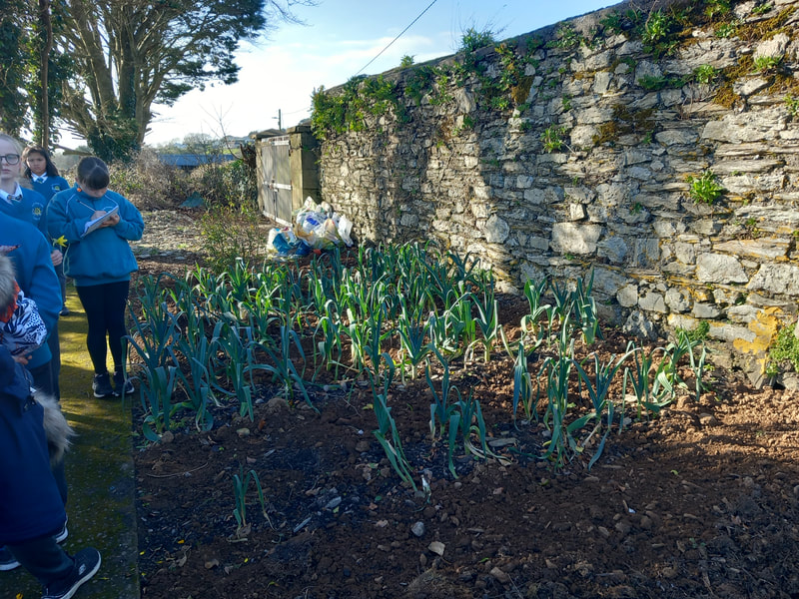
Gardening in the Friary
www.activeschoolflag.ie
Notes:
Many schools use music in the yard to generate physical activity. If your school doesn’t you can delete this slide.

Slide 4
Playground Leaders
Playground leaders from 3rd and 4th classes worked with children from Junior and Senior Infants, leaders from 5th and 6th classes worked with children from 1st and 2nd classes. Initially we did this 5 days a week, then we reviewed, took a short break and then they did this one day a week.
They were provided with notes to paly gams that use little to no equipment.
www.activeschoolflag.ie
Notes:
Please provide evidence of Playground Leaders in action. If this is not possible due to Covid-restrictions please explain this in your application form and delete this slide.

Slide 5
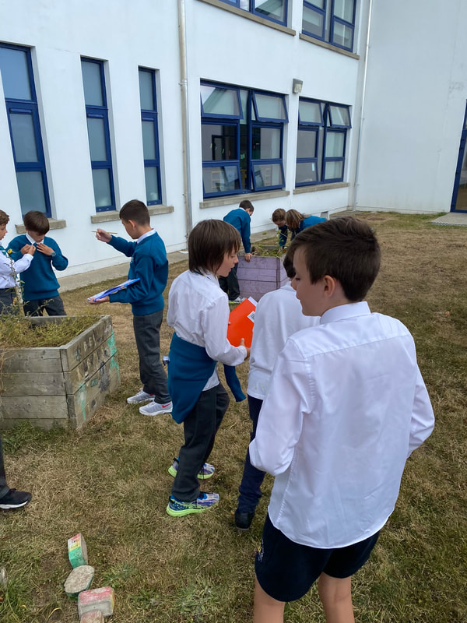
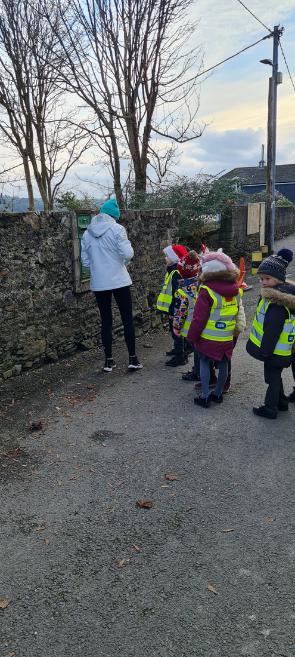
Minibeast Hunt and Aistear walk to postbox

Slide 6
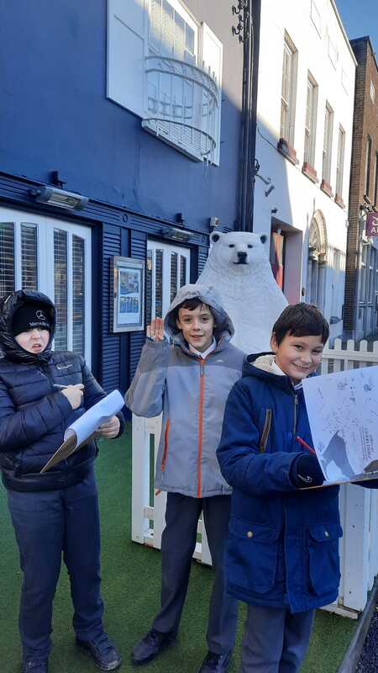
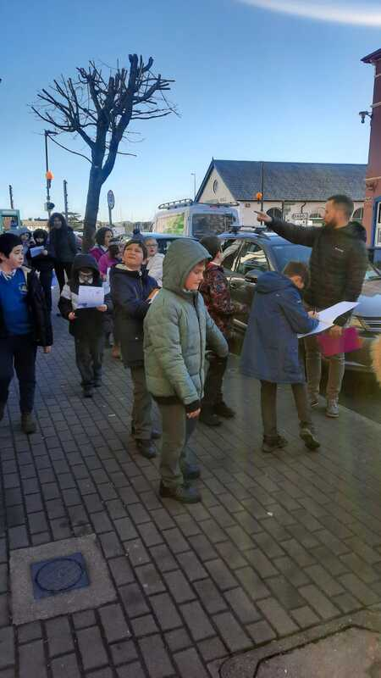
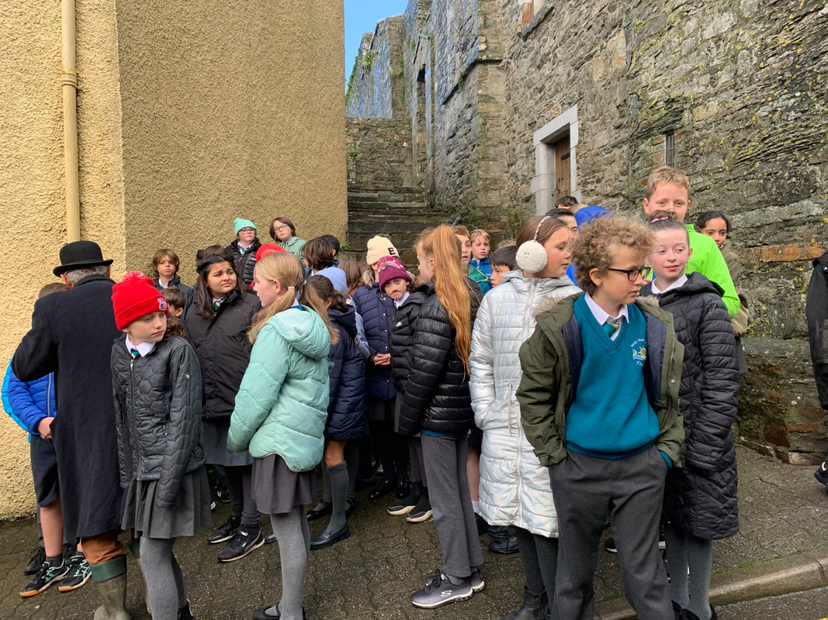
Geography Trail and Ghost Tour

Slide 7
Our Active School Walkway is used to:
www.activeschoolflag.ie
Notes:
WALKWAY signage is provided to registered schools that attend the Walkway webinar scheduled every spring.

Slide 8
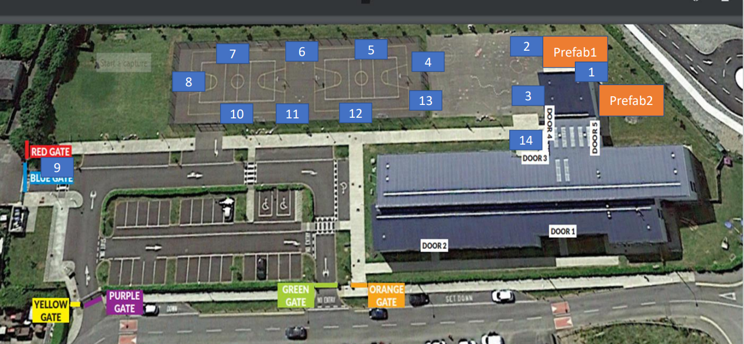
Our WALKWAY Route
www.activeschoolflag.ie
Notes:
Please provide evidence of the signposted Walkway route on your school grounds

Slide 9
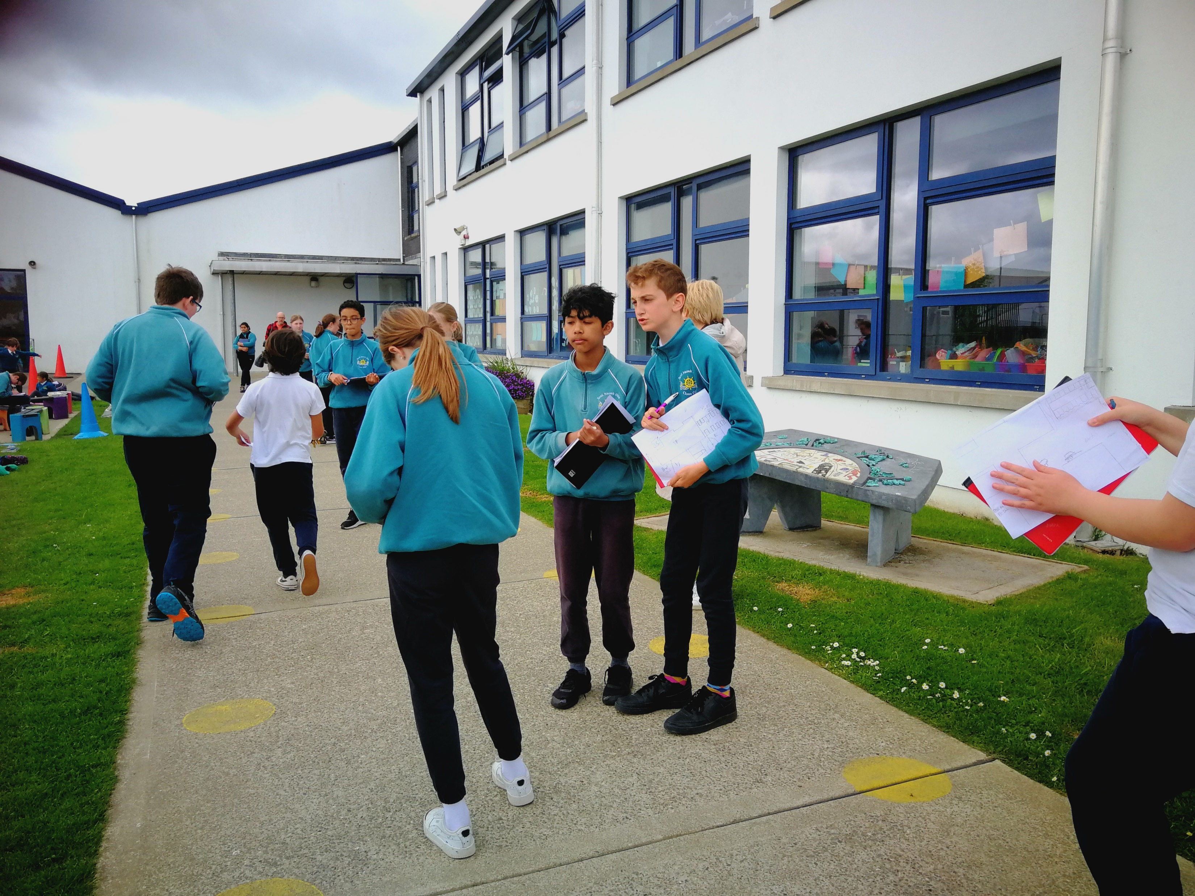
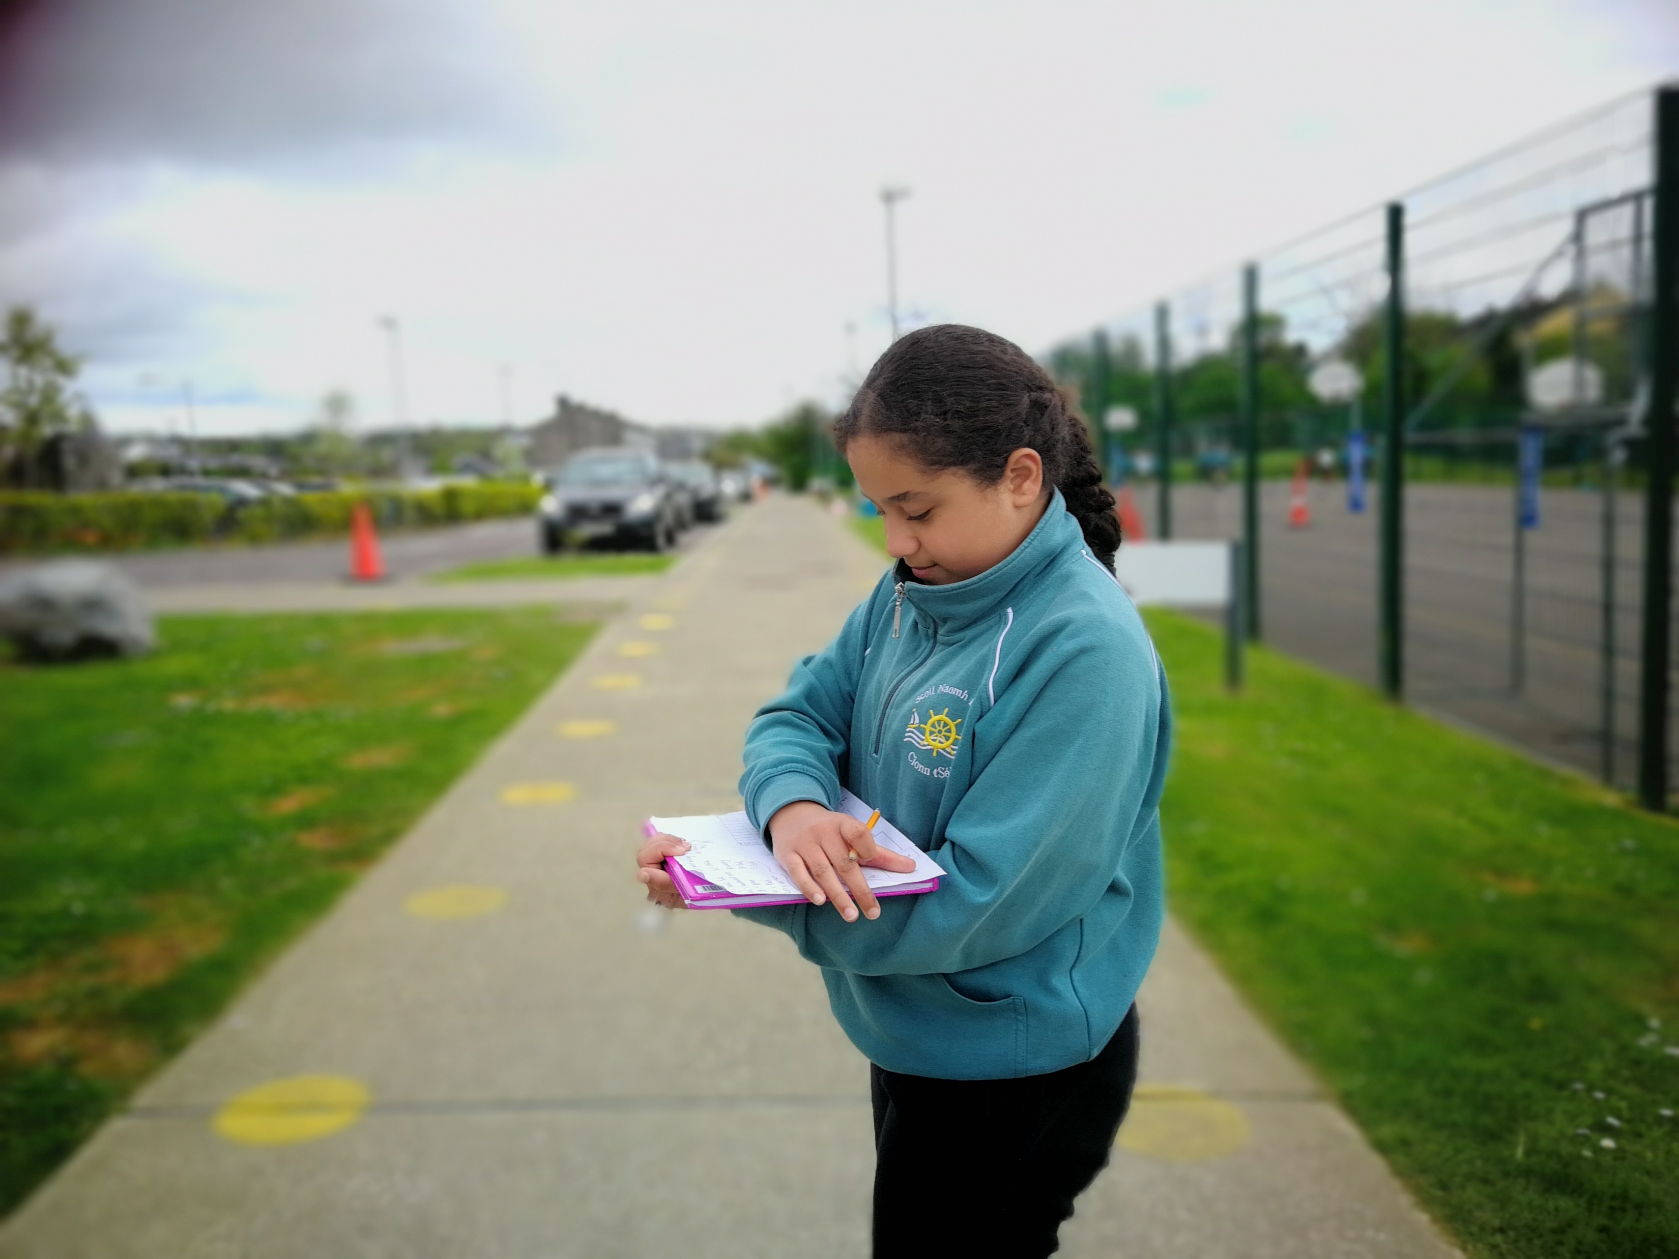
WALKWAY Activities
www.activeschoolflag.ie
Notes:
Please provide evidence of your Walkway route and the Walkway challenges in use.

Slide 10
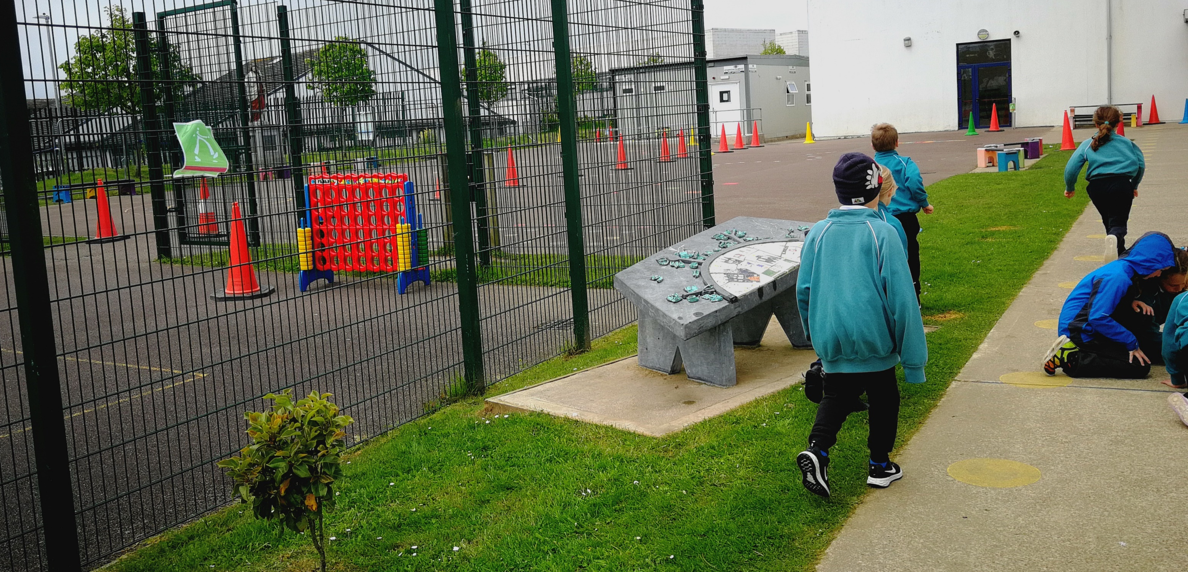

Slide 11
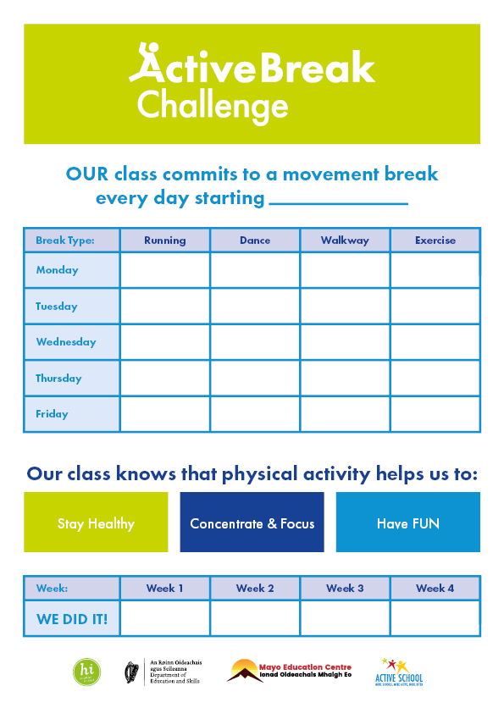
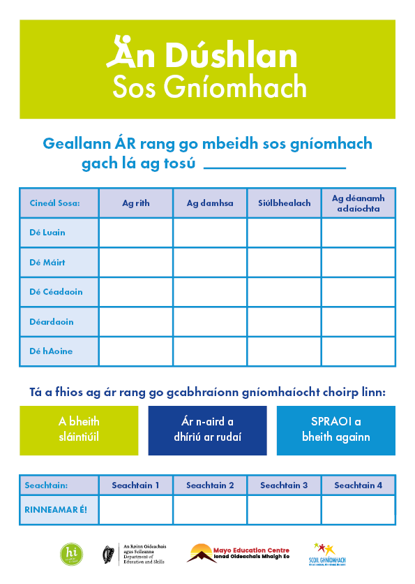
Active Breaks Challenge
Dates:
30/01-24/02
All classes participated.
Challenge lasted 4 weeks.
Variety in active breaks.
Notes:
This is a KEY part of the ASF process and should be organized as a whole of school activity.
Please insert the dates that your school ran this challenge in the box provided at the top of this page

Slide 12
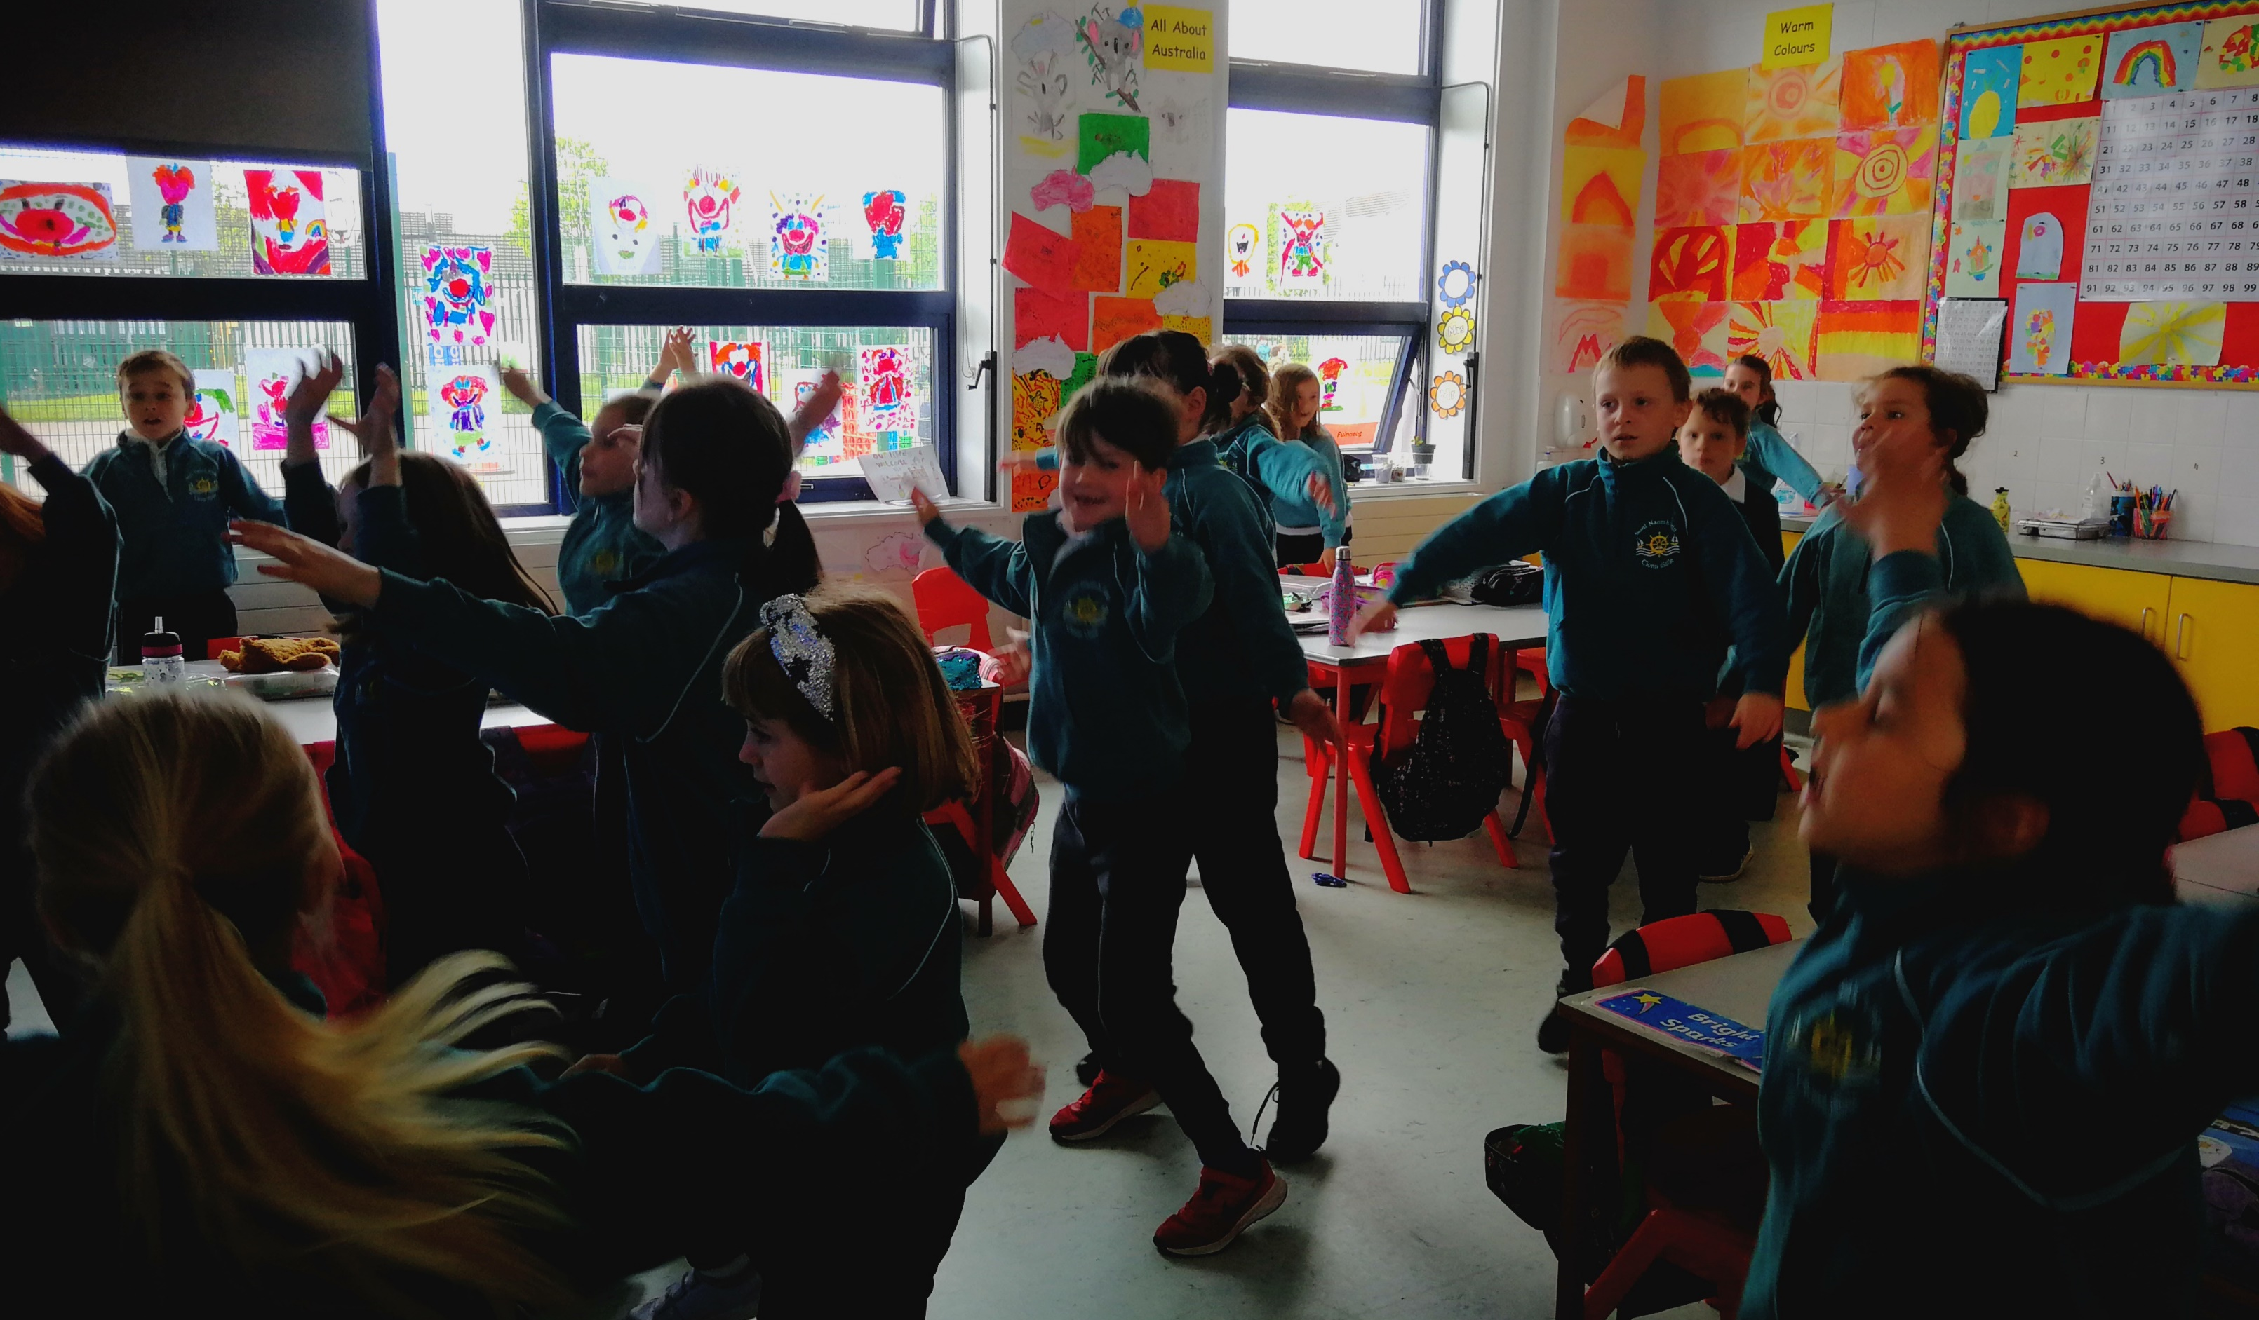
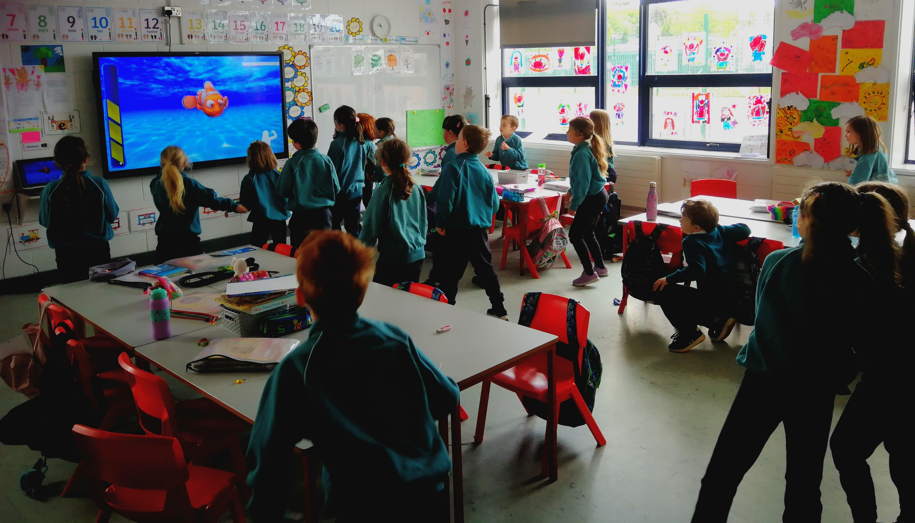
Active Breaks: Juniors
www.activeschoolflag.ie
Notes:
Please provide evidence of junior classes participating in this challenge

Slide 13
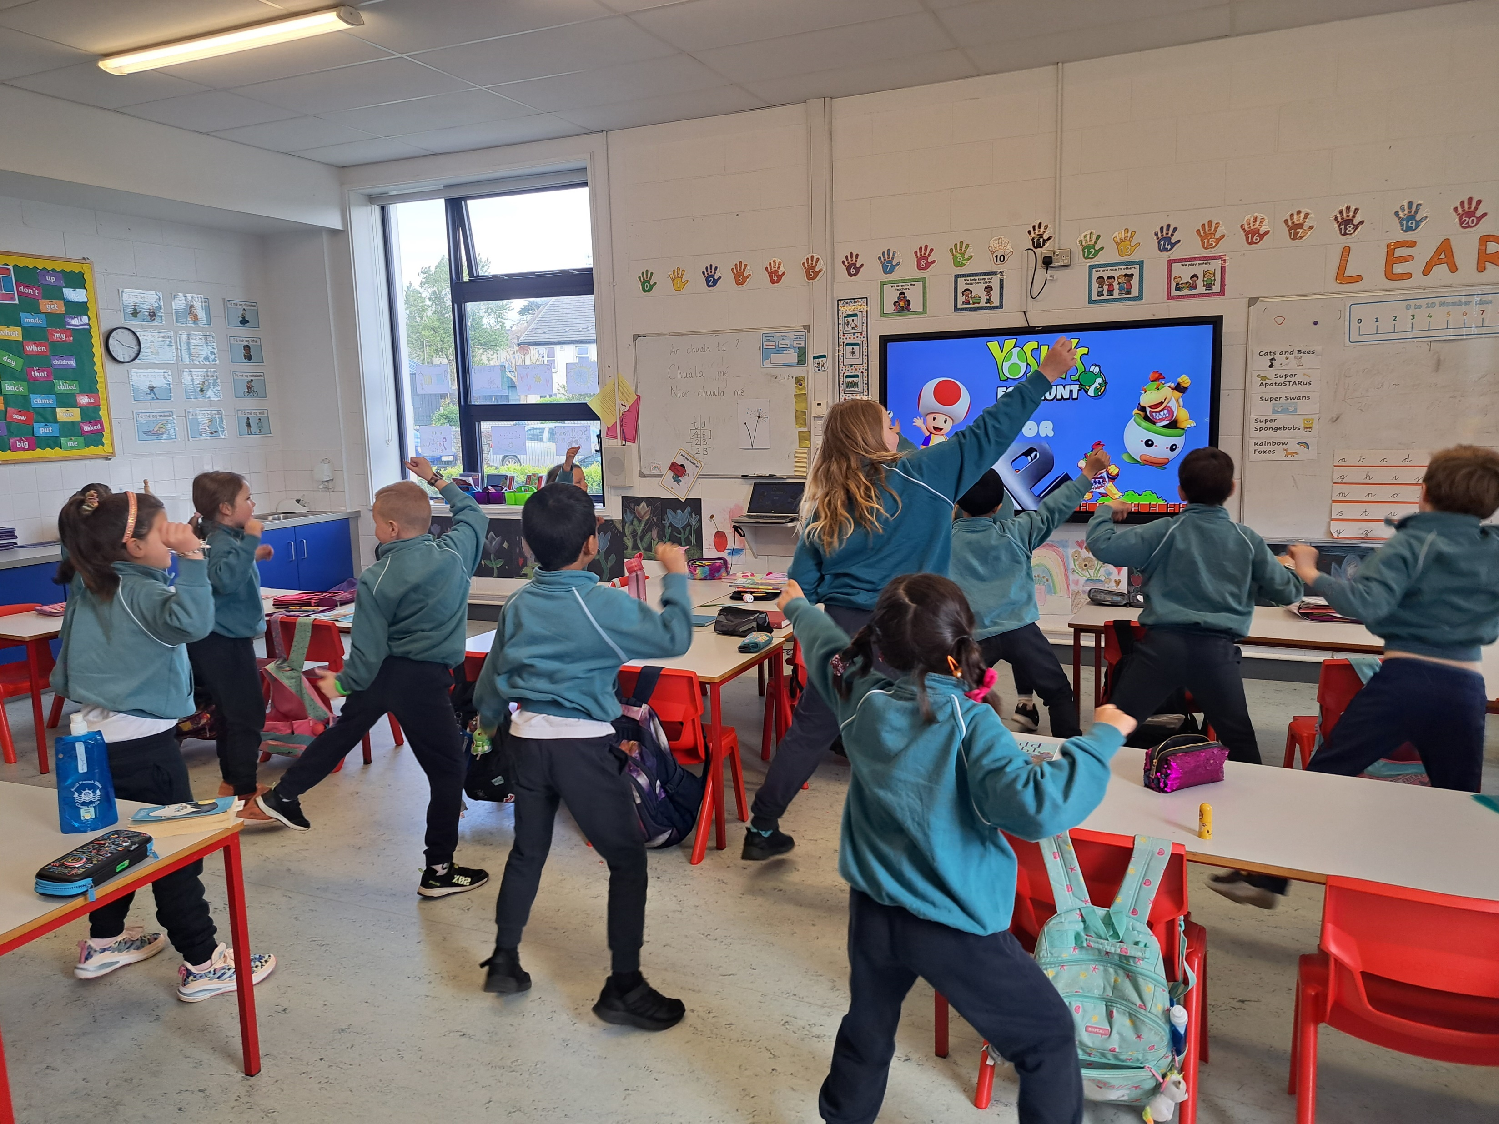
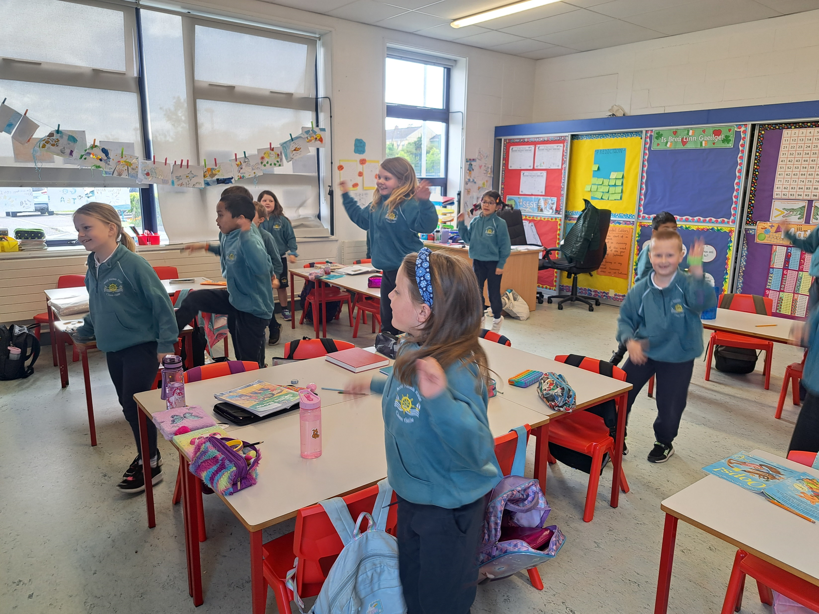
Active Breaks: Seniors
www.activeschoolflag.ie
Notes:
Please provide evidence of senior classes participating in this challenge

Slide 14
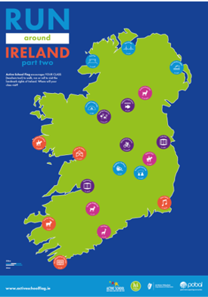
Running Challenge
Dates:
20/03-28/04
All classes participated.
Challenge lasted 4 weeks.
Running promoted in a FUN and inclusive way.
Notes:
This is a KEY part of the ASF process and should be organized as a whole of school activity.
Please insert the dates that your school ran this challenge in the box provided at the top of this page.

Slide 15
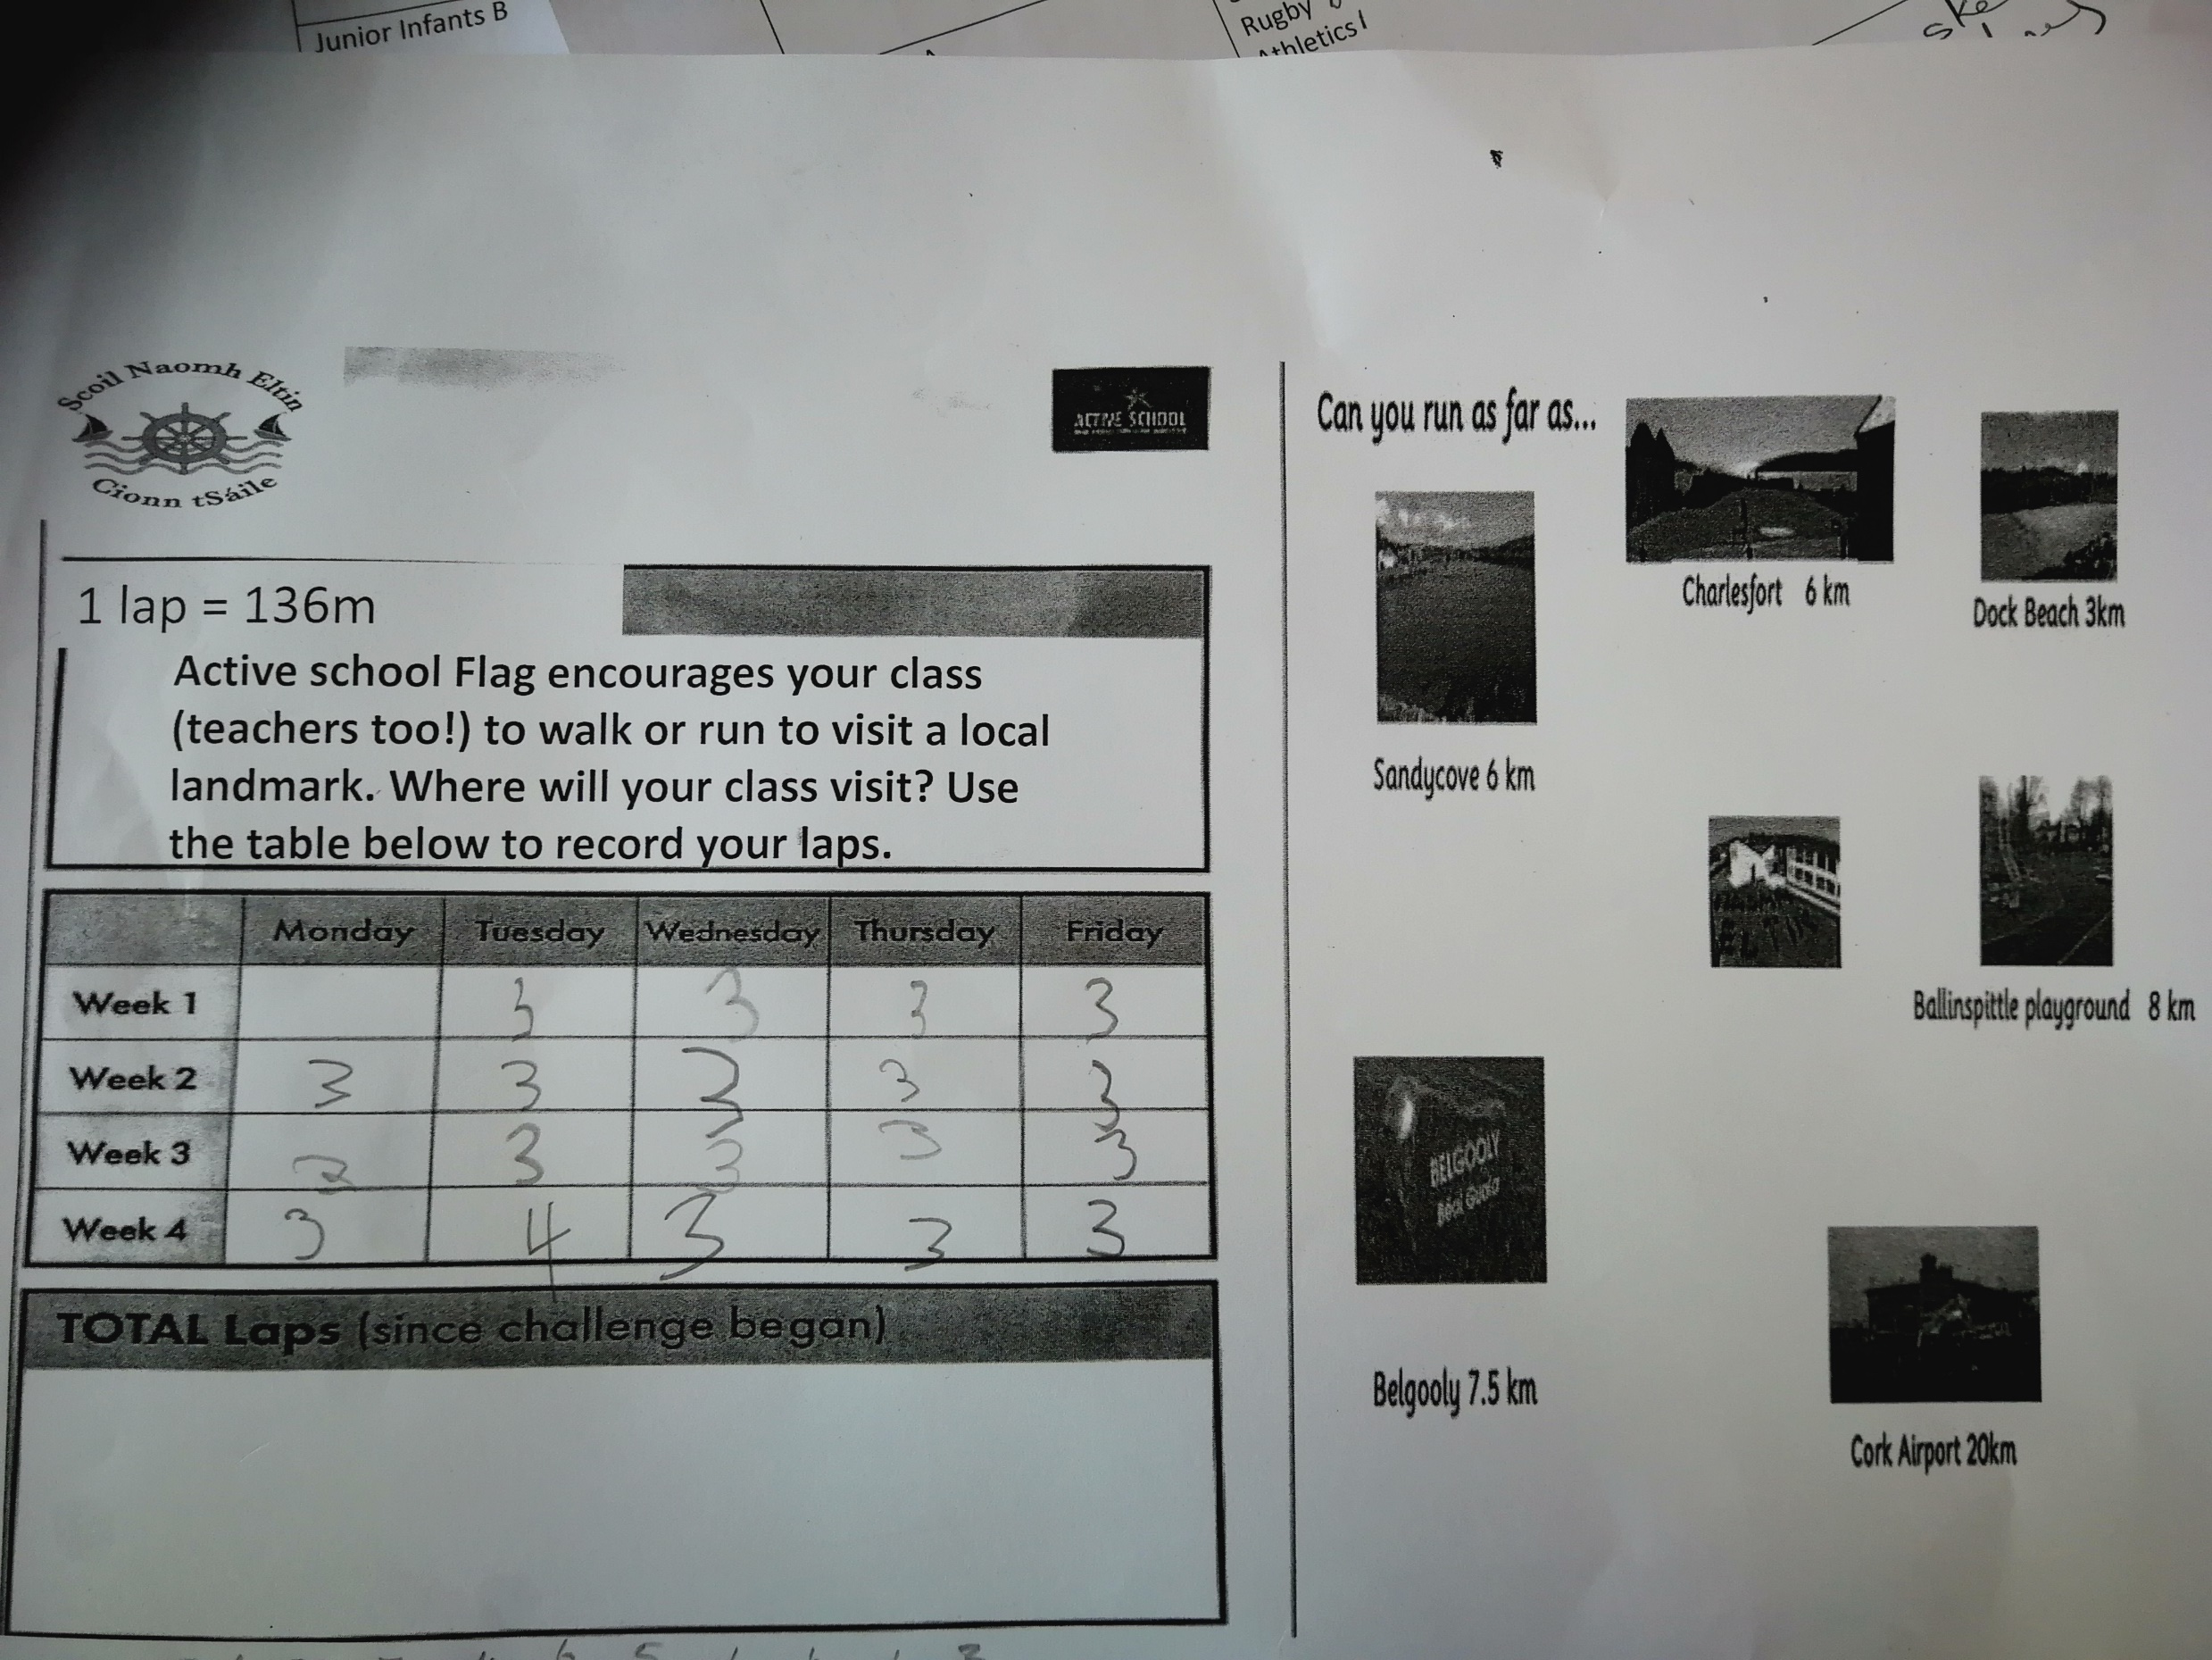

Slide 16
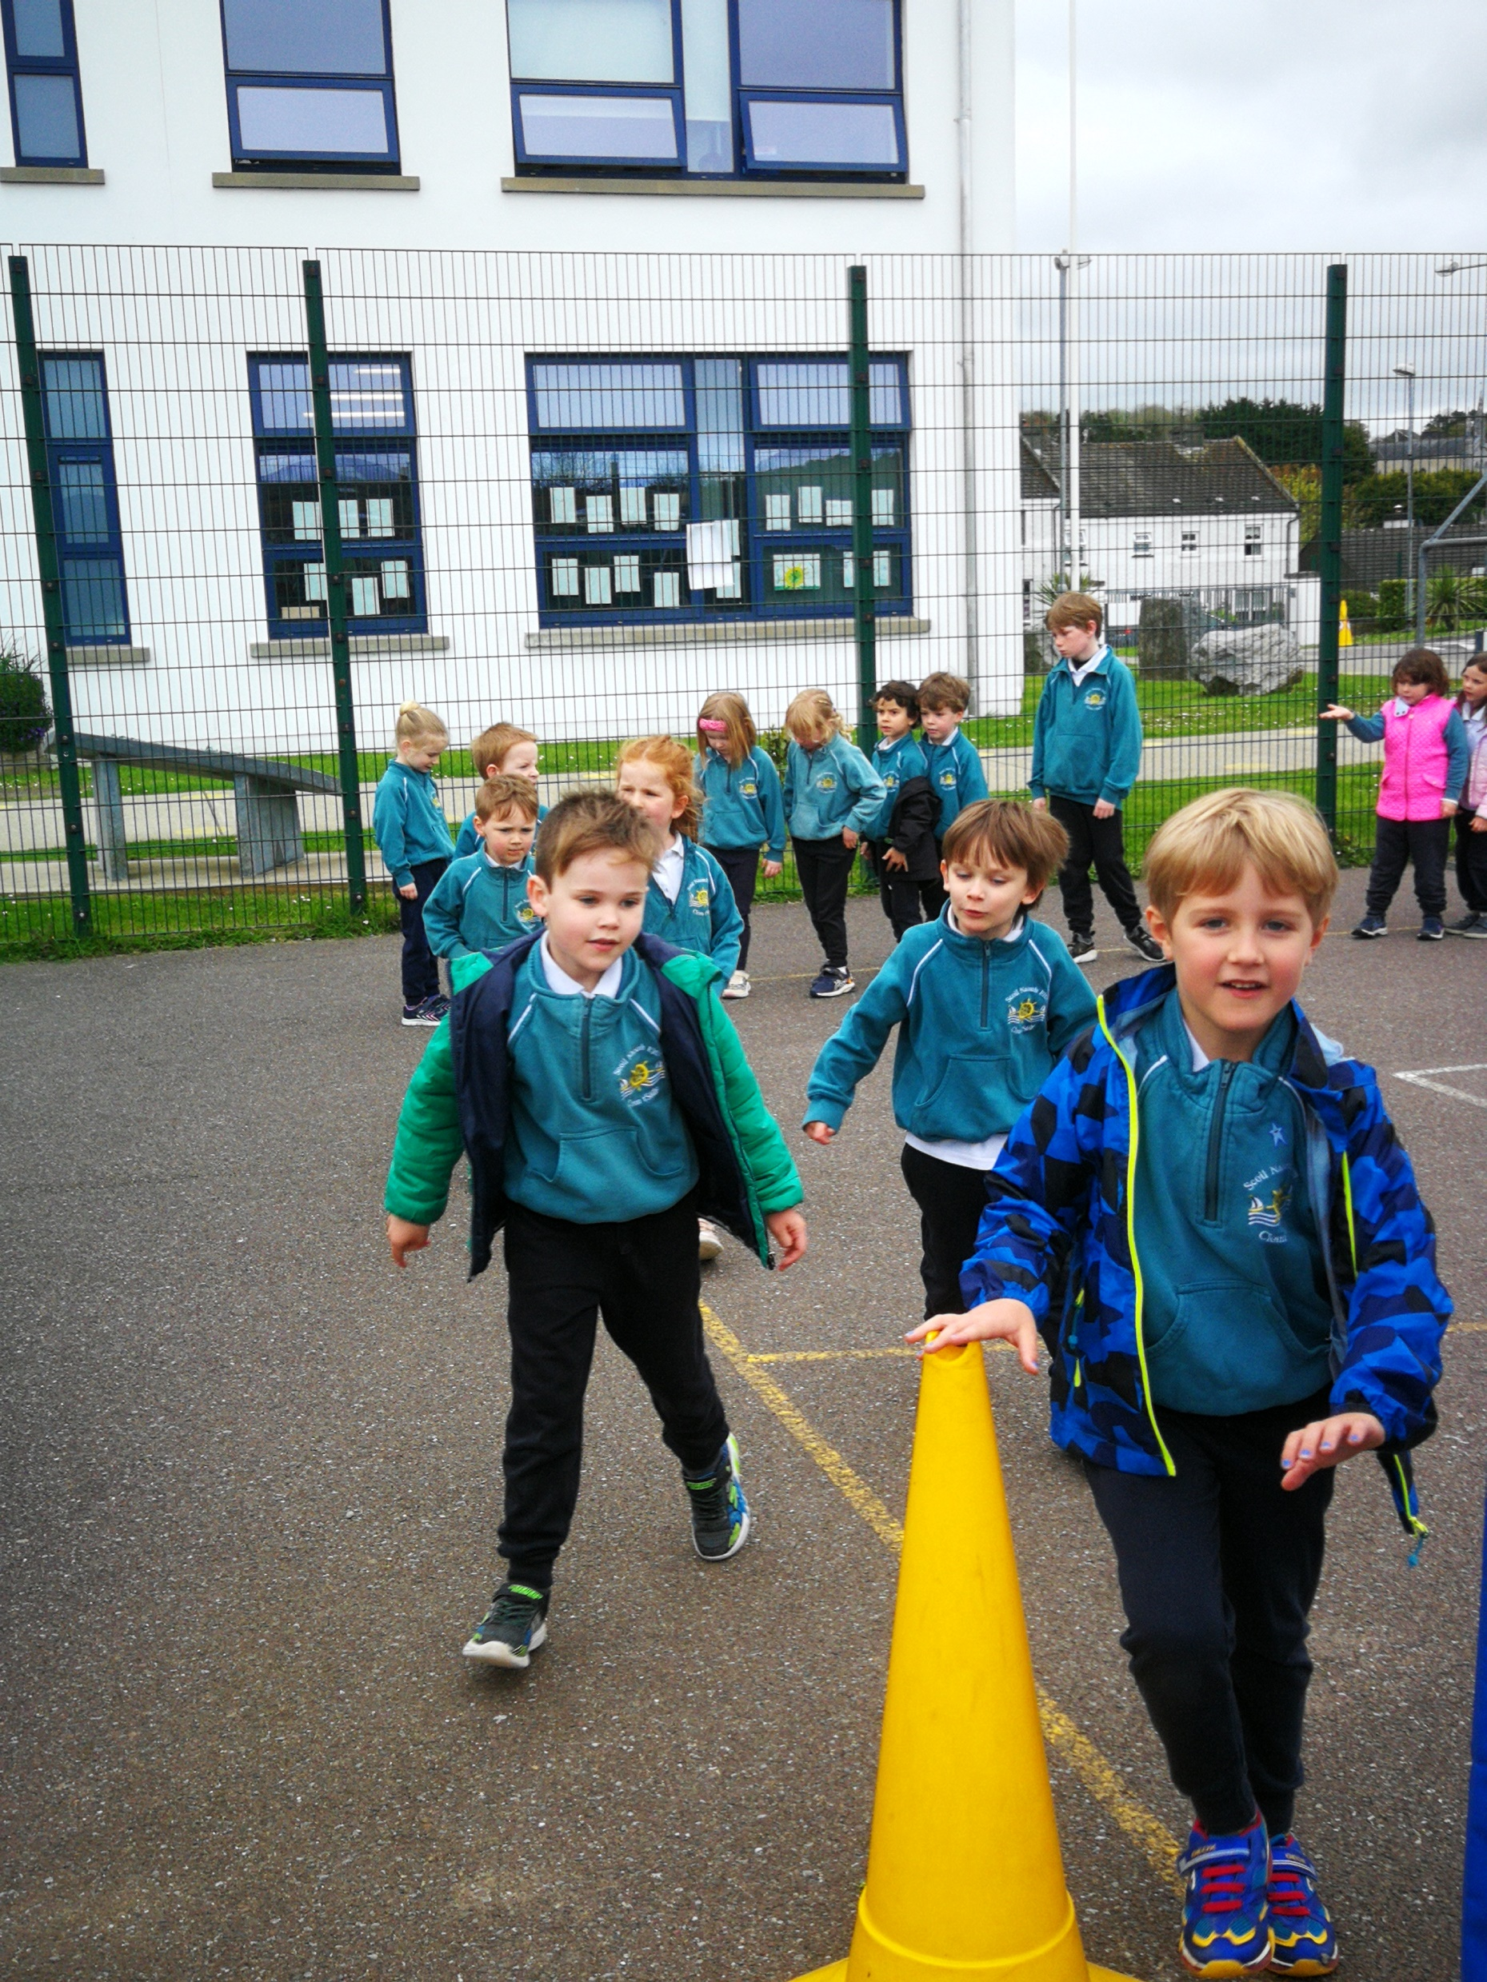
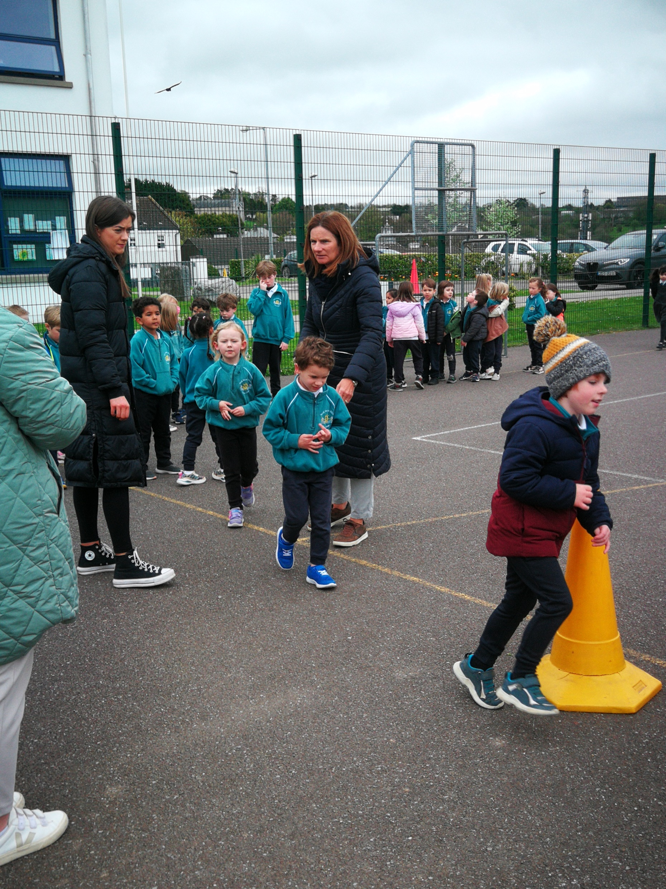
Running Challenge: Juniors
www.activeschoolflag.ie
Notes:
Please provide evidence of junior classes participating in this challenge

Slide 17
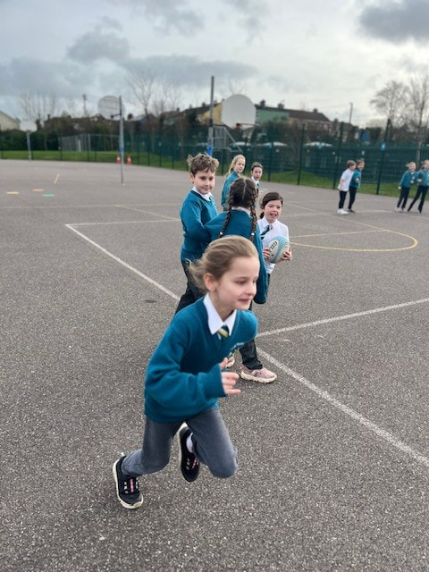
Running Challenge: Seniors
www.activeschoolflag.ie
Notes:
Please provide evidence of senior classes participating in this challenge

Slide 18
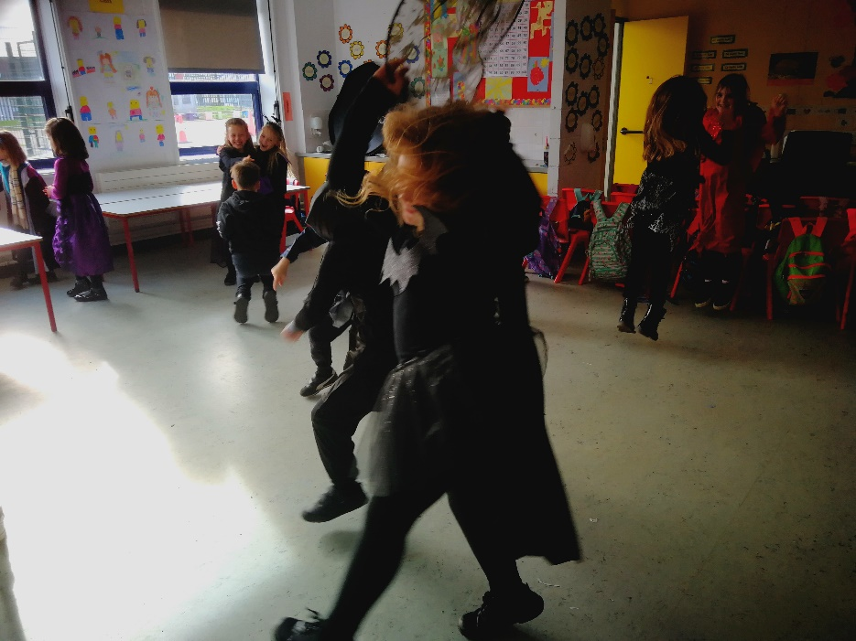
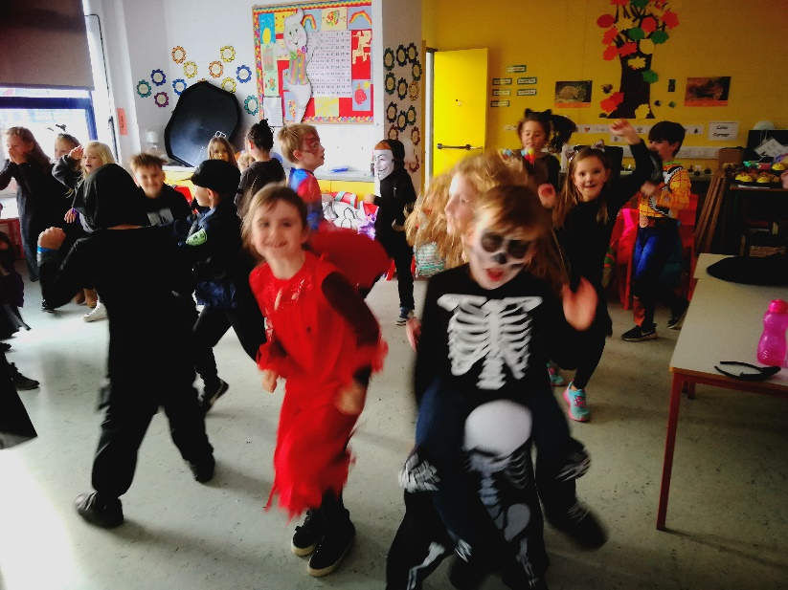
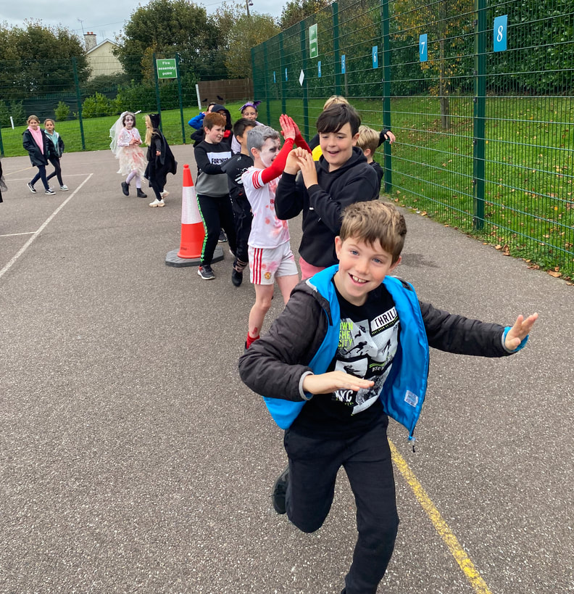
Active Halloween Disco
www.activeschoolflag.ie
Notes:
Please provide evidence of your Active Halloween activities

Slide 19
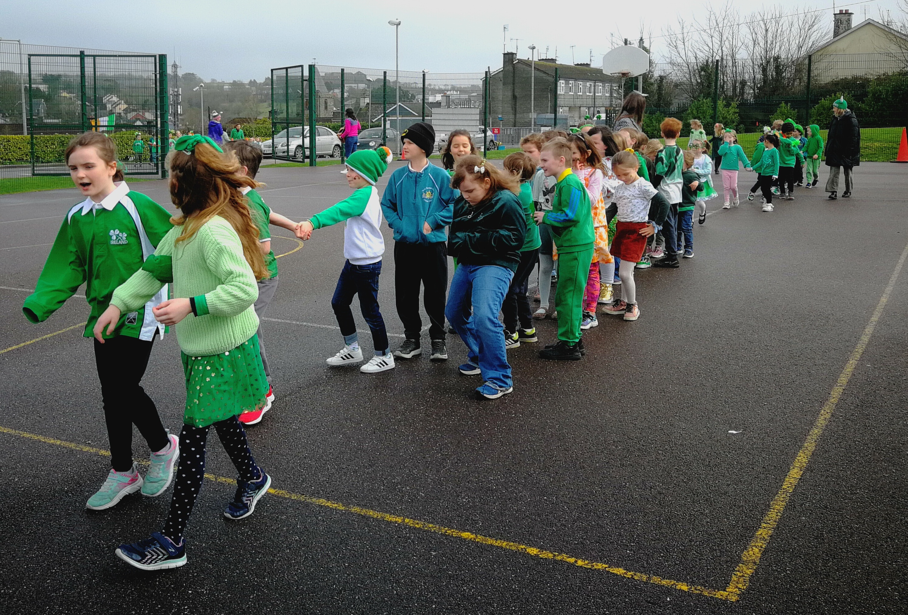
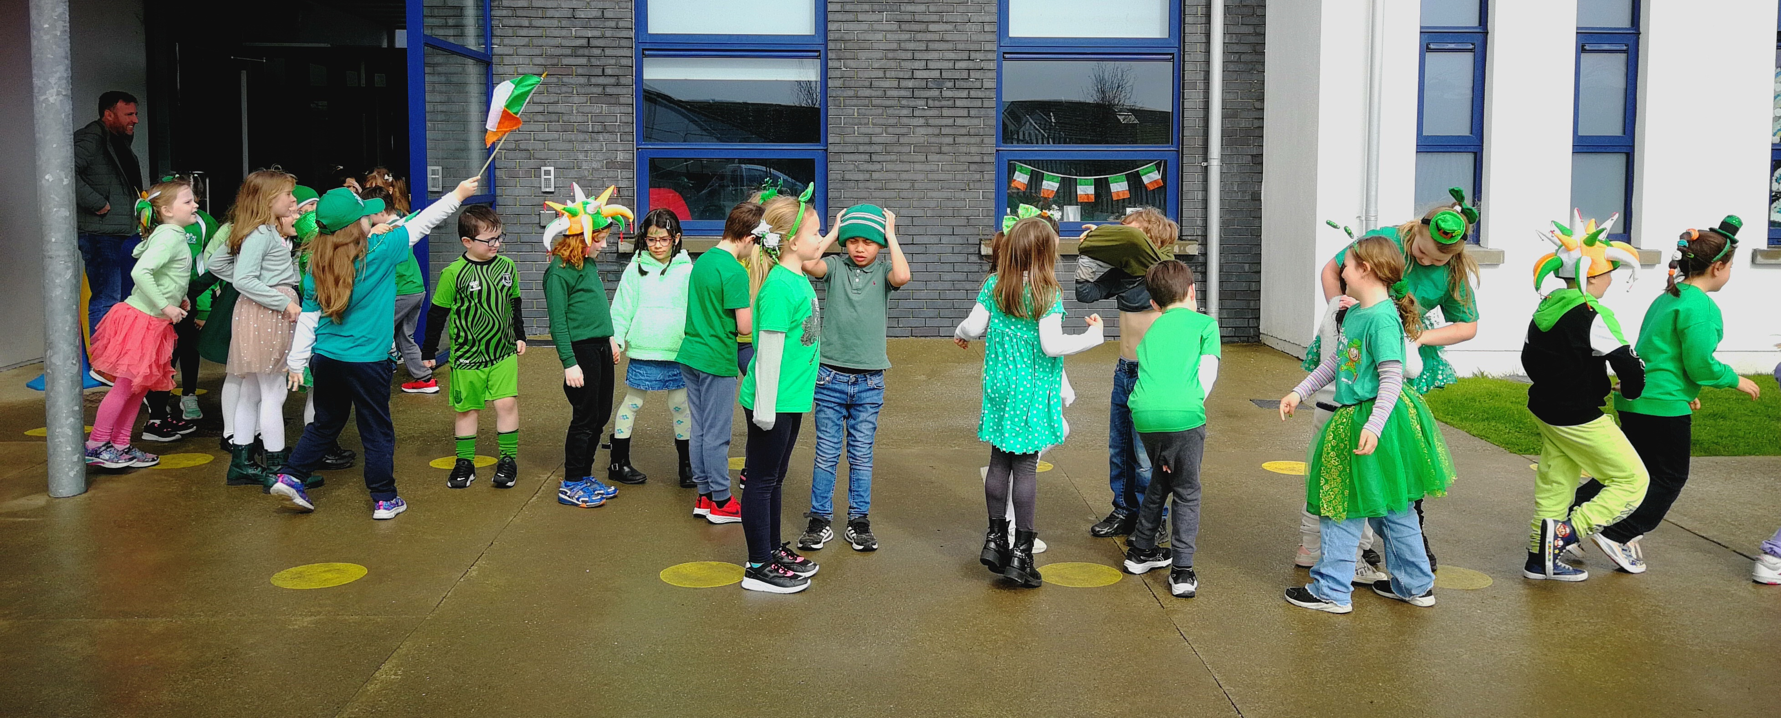
St Patrick’s Day Parade
www.activeschoolflag.ie
Notes:
Please provide evidence of your Santa Dash/other activities that you ran to energize the lead up to the Christmas holidays

Slide 20
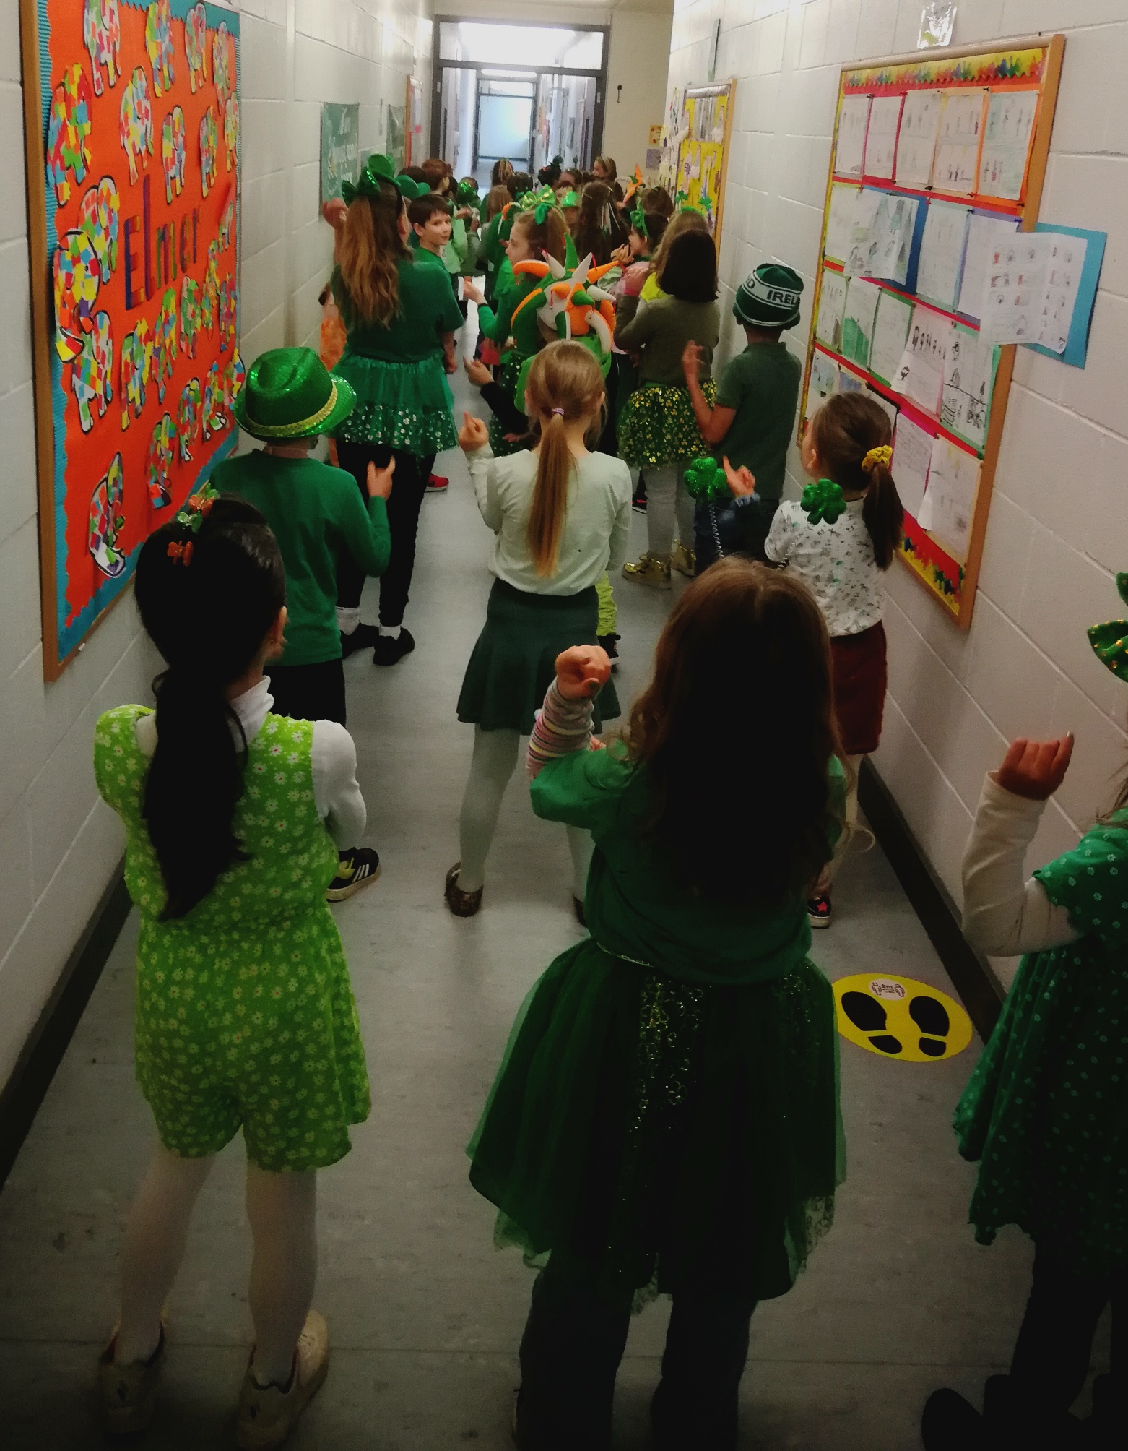
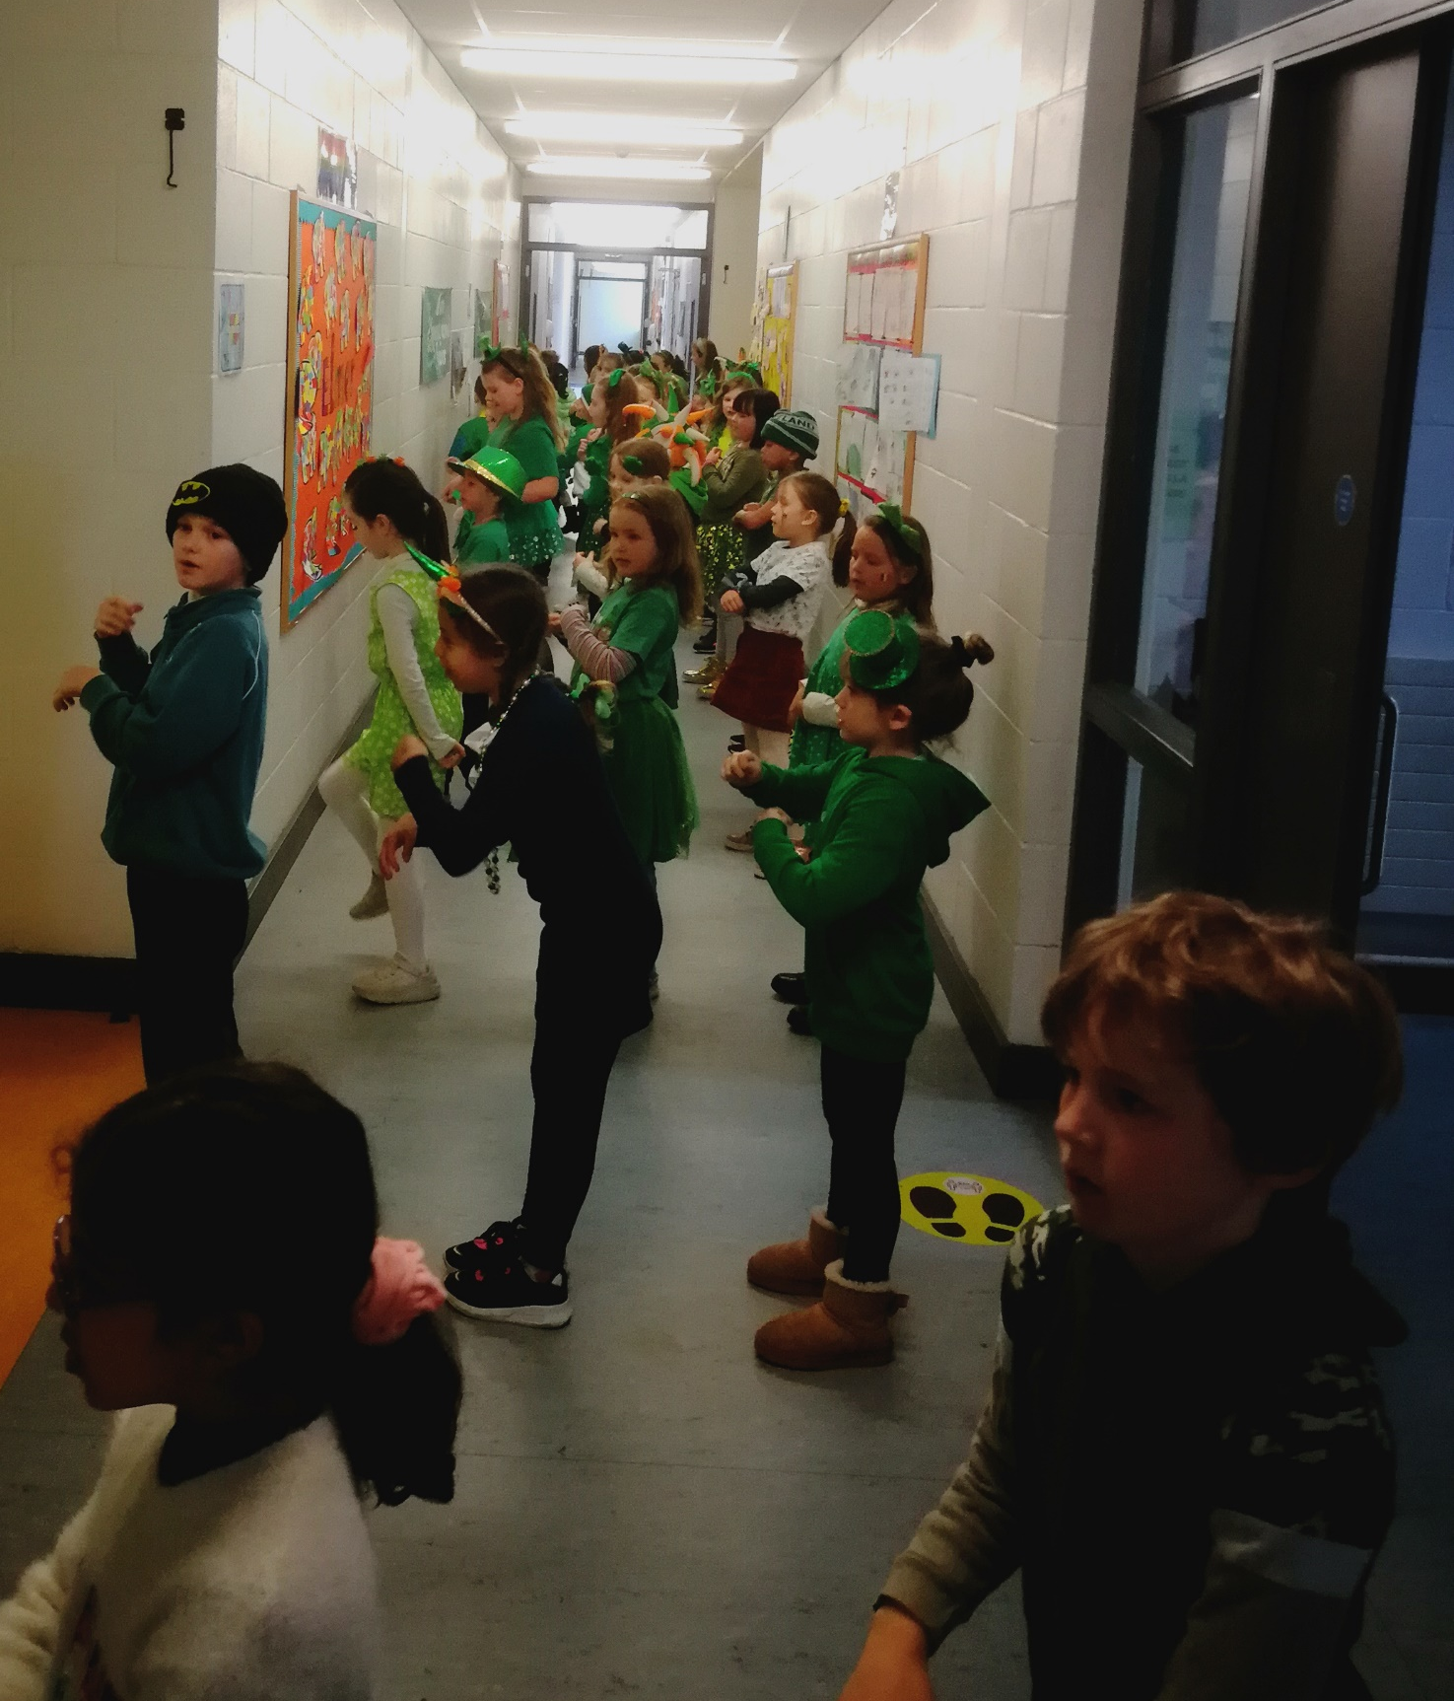
St Patrick’s Day Céilí

Slide 21
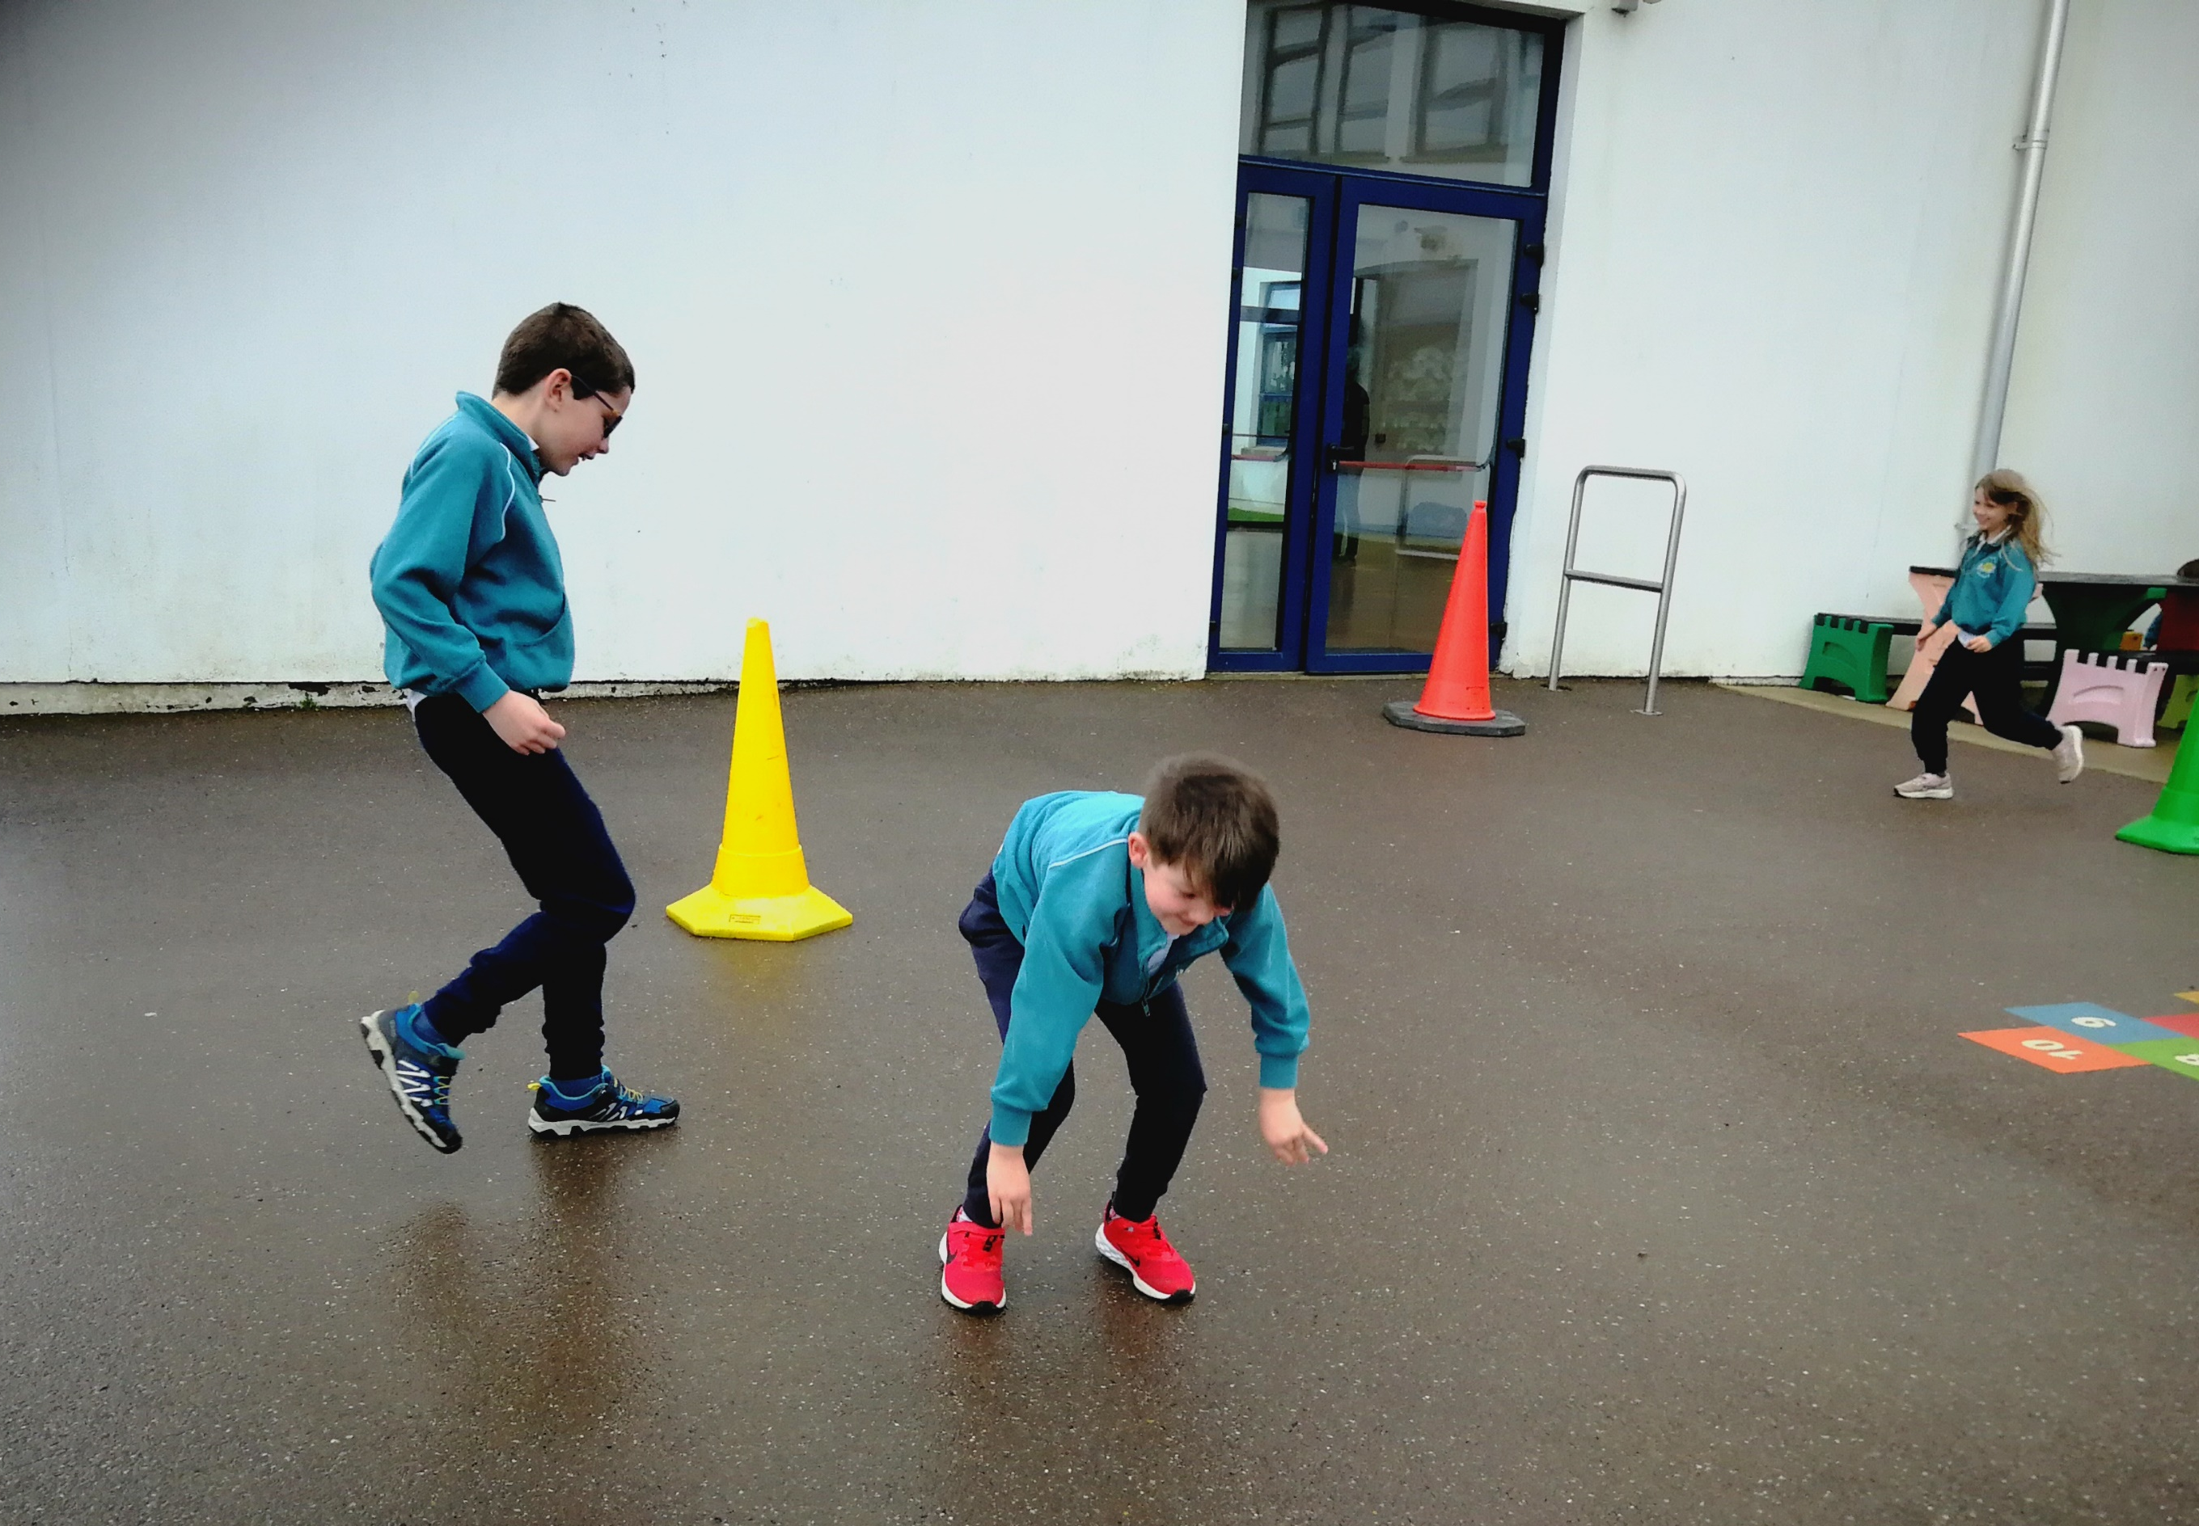
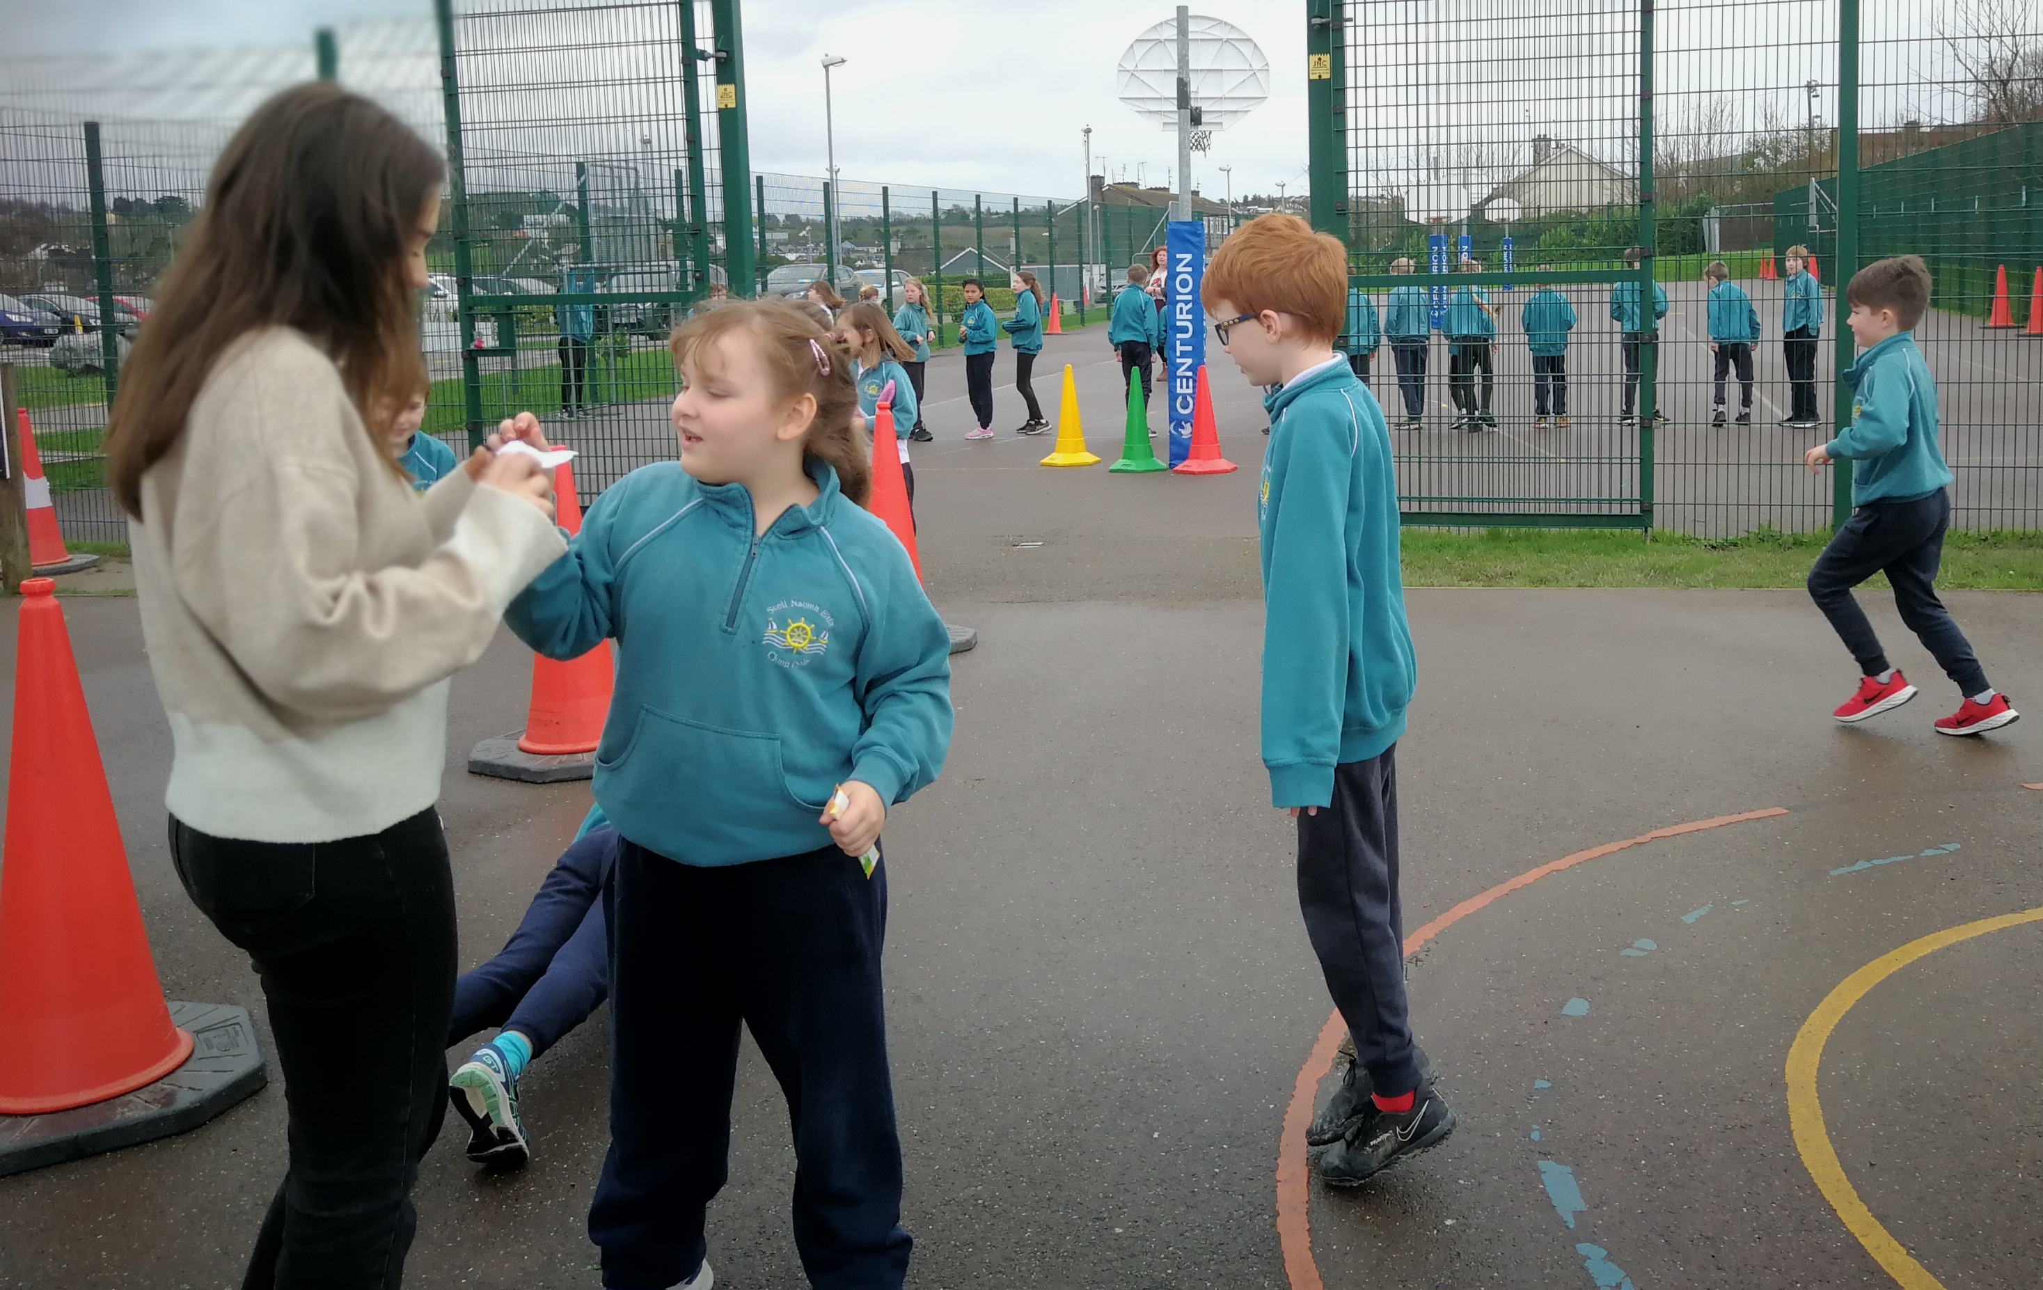
Easter Egg Exercise Hunt

Slide 22
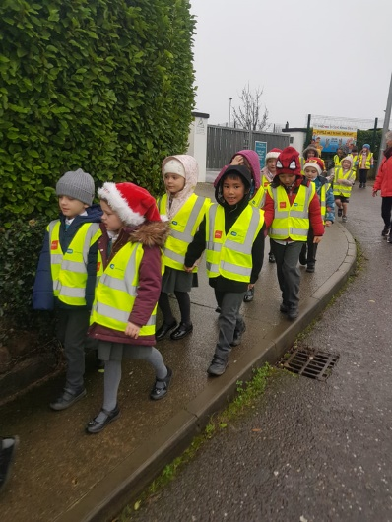
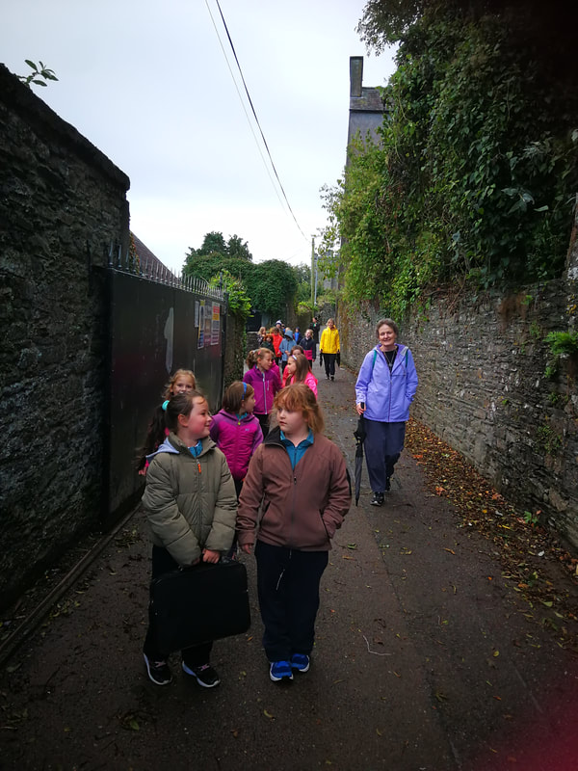
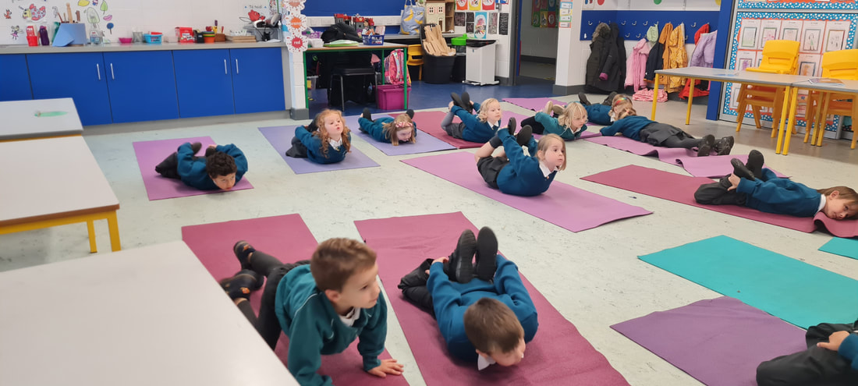
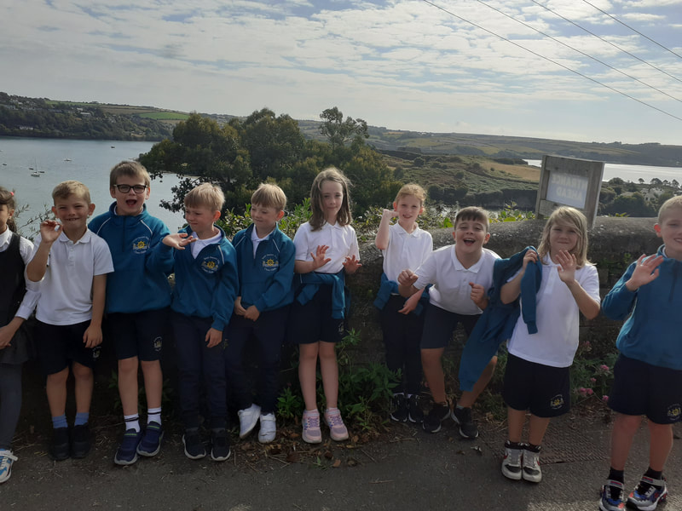
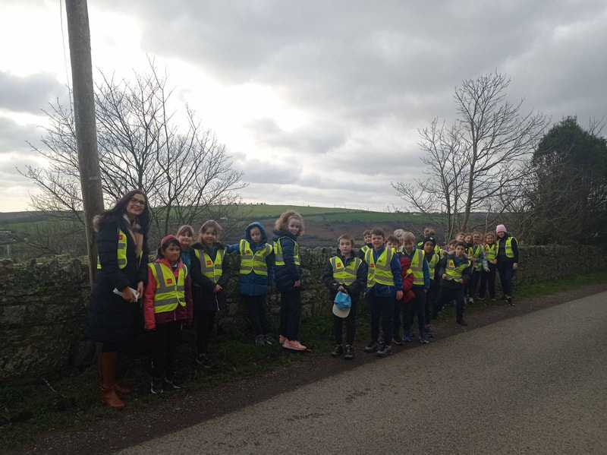
Workout Wednesdays
www.activeschoolflag.ie
Notes:
Please provide evidence of your participation in #FeelGoodFridays (if applicable)

Slide 23
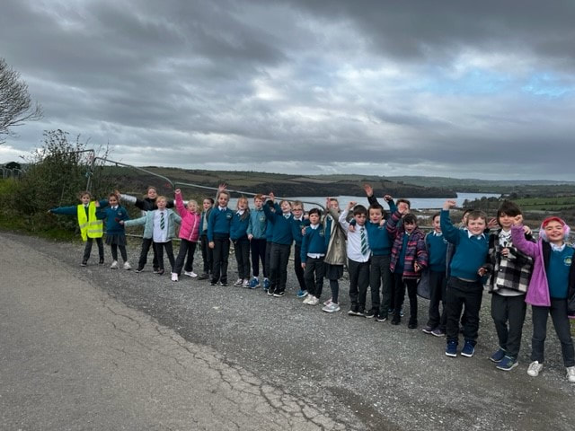
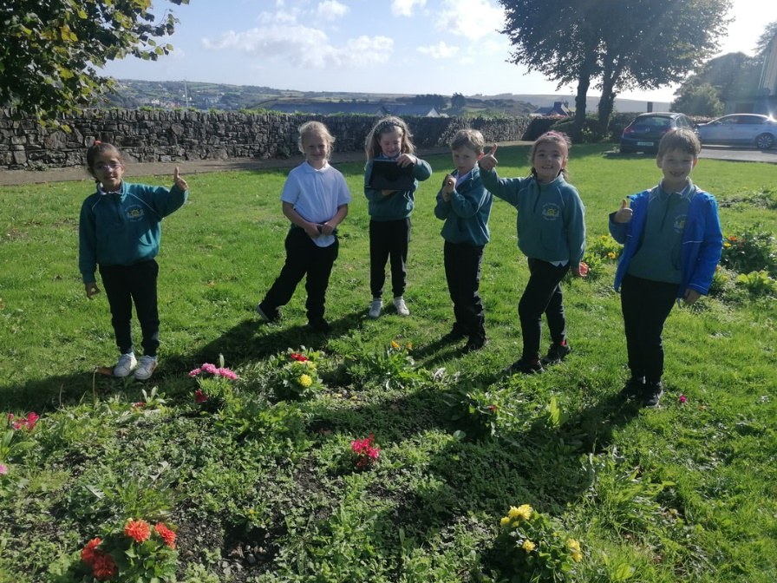
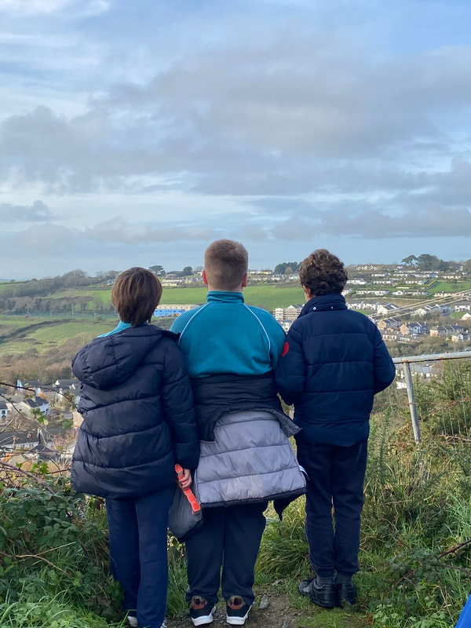
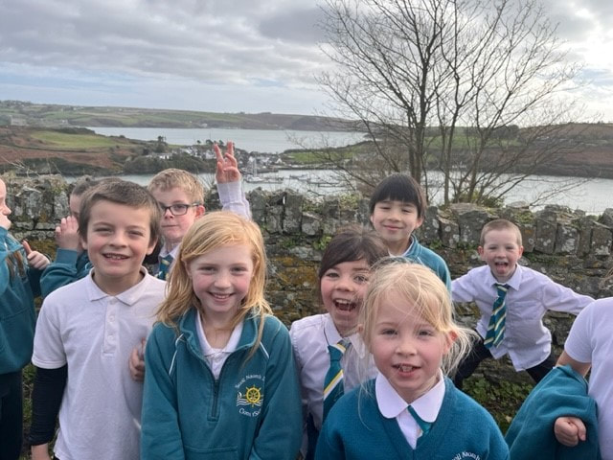
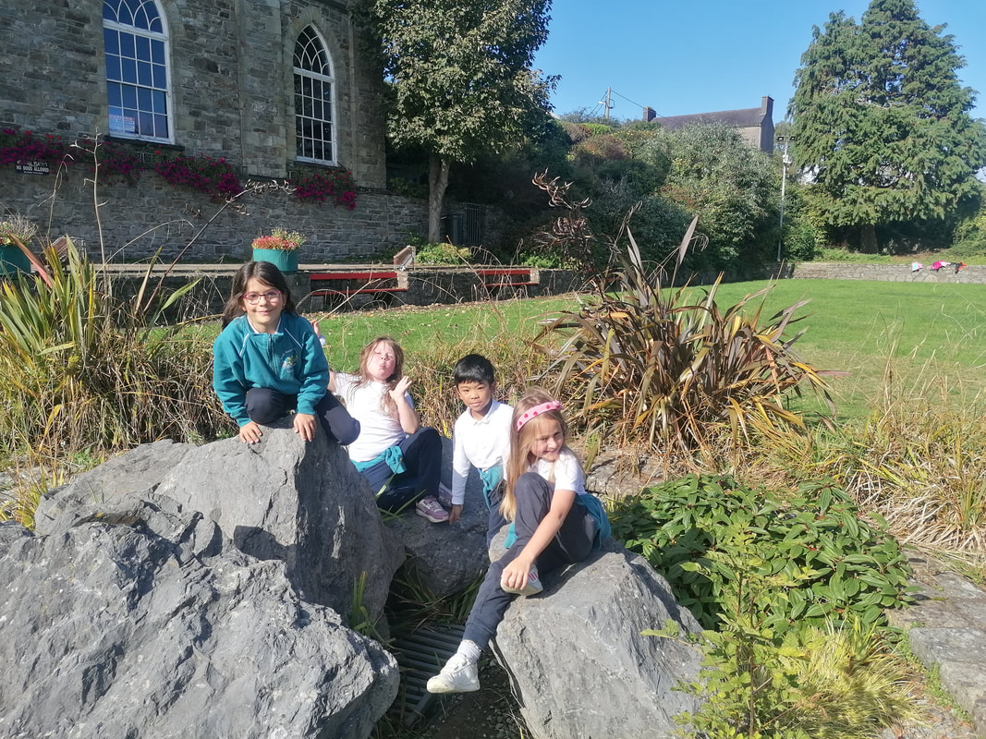

Slide 24
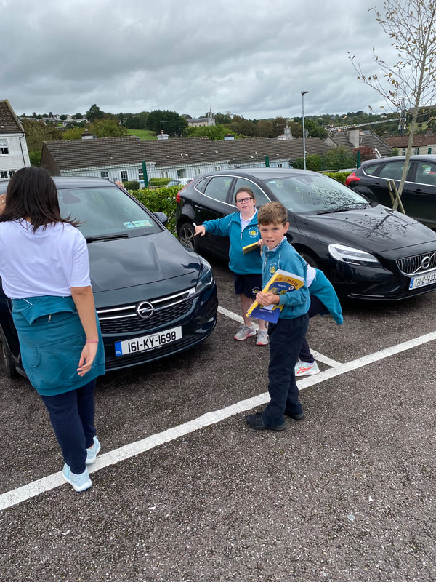
Decreasing Sedentary Time
www.activeschoolflag.ie
Notes:
This criterion applies to RENEWAL schools. Please provide evidence of the actions that classes agreed, with their teachers, to decrease sedentary time.
New applicant schools can delete this slide.

